Slide 1

Introduction to Carbon Neutral Villages
Jos Chathukulam
Director
Centre for Rural Management (CRM)
Kottayam , Kerala (India), email: joschathukulam@gmail.com
Presented in the Two Day Training on Strategies for Planning and Implementation of Carbon Neutral Villages and Empowering Rural Woman through SHGs held on 19 & 20 February 2024 organized by Directorate of Rural Development and Panchayati Raj, Govt. of Manipur.

Slide 2
Carbon Neutrality
Low carbon development is the premise of carbon neutrality, and emission reduction and carbon sinks are the basis of carbon neutrality.
Carbon sink refers to a forest, ocean, or other natural environment viewed in terms of its ability to absorb carbon dioxide from the atmosphere.
Carbon neutrality involves balancing carbon emissions and carbon sink absorption.
This can be done by offsetting carbon dioxide emissions
All global greenhouse gas (GHG) emissions must be offset through carbon sequestration to achieve carbon neutrality (Das et al., 2022)

Slide 3
Carbon Neutrality – A Brief Literature Review
The realization of carbon neutrality cannot be fully achieved by one single perspective and requires a comprehensive and systematic analysis of technology, economy, and society.
Carbon neutrality is a goal or process in which the GHG emissions generated by human, economic and social activities are captured to use or store for net-zero emissions to the atmosphere through carbon sink and other technical means. The concept of carbon neutrality is derived from net-zero emissions (Jia and Lin, 2021)
The term carbon-neutrality in general refers to “achieving zero carbon emissions by balancing a measured amount of carbon released with an equivalent amount sequestered or offset or buying enough carbon credits to make up the difference,” (Brown 2018).

Slide 4
Carbon Neutrality – A Brief Literature Review
Carbon neutrality means balancing emitting carbon and absorbing carbon from the atmosphere in carbon sinks (European Parliament, 2019).
Carbon neutrality, or having a net zero carbon footprint, refers to achieving net zero carbon emissions by balancing a measured amount of carbon released with an equivalent amount sequestered or offset (United Nations Environment Programme, 2019)

Slide 5
Carbon Neutrality – A Brief Literature Review
Net-zero carbon dioxide (CO2) emissions are achieved when anthropogenic CO2 emissions are balanced globally by anthropogenic CO2 removals over a specified period. Net zero CO2 emissions are also referred to as carbon neutrality (IPCC, 2018)
Net-zero emissions are achieved when anthropogenic emissions of greenhouse gases to the atmosphere are balanced by anthropogenic removals over a specified period (IPCC, 2018)

Slide 6
Carbon Neutrality – A Brief Literature Review
Paris Climate Agreement (2015) gave carbon neutrality a major traction.
Paris Agreement's long-term objective is to achieve net-zero greenhouse gas emissions by 2050.
The Paris Agreement aims to “substantially reduce global greenhouse gas emissions to limit global temperature increase in this century to 2 degree Celsius,” (Paris Agreement Article 2 (a))
Climate action is the thirteenth Sustainable Development Goal (SDG) of the 2030 Agenda ("take urgent action to combat climate change and its impacts") and is intricately linked to “carbon-neutrality”.
Emission reduction for low carbon development is the first step towards carbon neutrality (Wang et al., 2021, Wang et al., 2021, Wang et al., 2021; Wei et al., 2022).

Slide 7
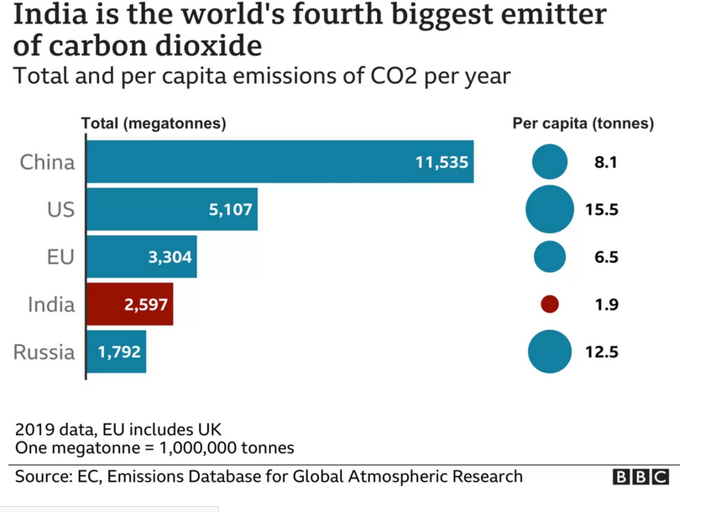
Carbon Neutrality in Indian Context
India is the fourth biggest emitter of carbon dioxide (CO2) after China, the United States and the European Union.
However, considering India’s huge population, its emissions per capita are much lower than other major world economies.
For instance, India emitted 1.9 tonnes of CO2 per head of population in 2019, compared with 15.5 tonnes for the US and 12.5 tonnes for Russia that year.

Slide 8
Carbon Neutrality in India
India has set a goal of reducing carbon emissions by 50% by 2030 and for the entire economy to be net zero by 2070.
COP26: India PM Narendra Modi pledges net zero by 2070 (BBC, November 2, 2021).
Nationally Determined Contributions (NDC) - India has said it will reduce the emissions intensity of its Gross Domestic Product (GDP) by 45% by 2030. This measures the amount of greenhouse gas emitted per unit of economic activity. India has a more ambitious target than the 33-35% cut set before COP26.
As part of the Energy Conservation (Amendment) Act 2022, the Indian government launched the “Carbon Credit Trading Scheme”.
“Carbon Credit Trading Scheme” is designed as a form of domestic emissions trading scheme and it aims to incentivize emission reductions across industrial and power sectors in the country.

Slide 9
Carbon Neutrality in India
The Long-Term Low-Carbon Development Strategy (LTLEDS), outlines India's long-term vision for decarbonization.
The Sustainable Energy Policy sets out the government's policies to promote renewable energy and energy efficiency.
The National Electric Mobility Mission Plan aims to promote electric vehicles in India.
Promoting renewable energy (RE) in the power generation sector is a critical part of the strategy, given the sector’s significant share in India’s emissions.
Policies to bring down carbon emissions in India includes guaranteed feed-in tariffs, accelerated depreciation of wind and solar assets, creation of green energy transmission corridors for evacuating RE from RE-rich states, creation of solar parks and ultra-mega electricity projects, and, most importantly, implementation of renewable purchase obligations (RPOs) (Climate Policy Database 2023).
The Government is promoting wind power projects in the entire country through private sector investment by providing various fiscal and financial incentives such as Accelerated Depreciation benefits; and concessional custom duty exemption on certain components of wind electric generators.

Slide 10
Carbon Neutrality in India
In a feed-in tariff scheme, providers of energy from renewable sources, such as solar, wind, or water, receive a price for what they produce based on the generation costs.
Accelerated Depreciation: Accelerated depreciation (AD) allows the developer to write off the asset value in the initial years of the project, thereby reducing the tax liability.
The Indian government grants accelerated depreciation on solar power plant fixed assets, allowing businesses to claim a depreciation rate of up to 40% in a year, significantly higher than the normal rate of 15% for general plant and machinery.

Slide 11
Carbon Neutrality in India
India has signed the declaration of the 2030 Agenda for Sustainable Development Goals (SDGs) of the United Nations.
Goal 13 of the SDGs focuses on urgent action required to combat climate change to strengthen resilience and adaptive capacity to climate hazards and to integrate climate change measures, policies, and strategies.
In 2016, India ratified the Paris Agreement, and the country is committed to creating a cumulative carbon sink of 2.5–3 billion tonnes of carbon dioxide through additional forest and tree cover by 2030.

Slide 12
Carbon Neutral Villages
Carbon-neutral villages can be defined as communities at the grassroots level adopting climate-resilient activities.
For example, some village communities adopt solar panels for power consumption, some use cloth bags, leaf and fiber bags, some use LED lights to bring down carbon-emissions, some adopting more vegan – friendly diet and climate-resilient agricultural practices, rainwater harvesting and so on.
The concept of ‘Carbon Neutral Community/Village’ denotes:
Zero carbon development at local self – government level.
Self – sufficiency in food and energy production at local level.
Promote self – sustenance through organic farming at grassroots level.
Conserve and expand green cover
Ensure a sustainable development of the society in harmony with nature.

Slide 13
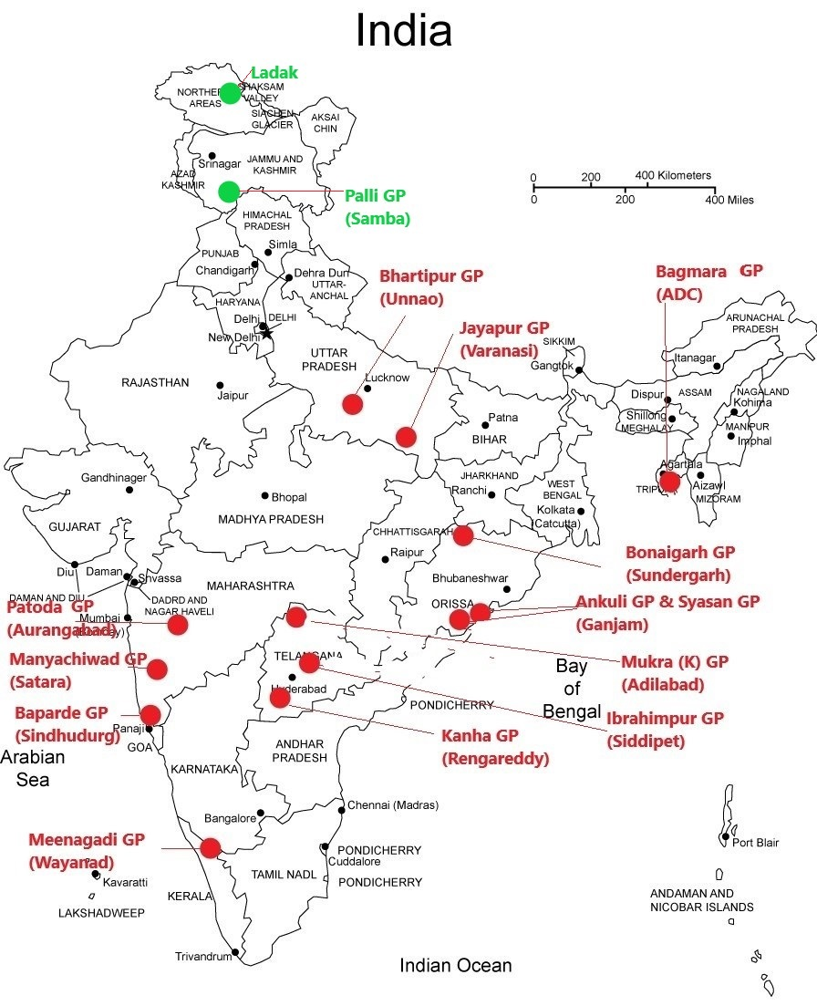
Carbon Neutral Villages in India
Palli village in Jammu's Samba district is India's first carbon-neutral panchayat.
Prime Minister Narendra Modi launched 500 KW solar plant as the first step towards embracing carbon neutrality.
The solar plant has 1,500 solar panels covering 6, 408 square meters and it provides electricity to 340 houses in the Palli panchayat.
The electricity generated at this solar power plant is distributed to the village, having a daily requirement of 2,000 units, through the local power grid station.
A total of 340 households in this panchayat have solar cookers, solar street lights, solar pumps for irrigating the fields.
Villagers use e-rickshaws, and e-buses.
12 Gram Panchayats have won Carbon Neutral Vishesh Panchayat Puraskar
Phayeng, Imphal

Slide 14
Carbon Neutral Villages in India
Phayeng in Manipur, is a notable carbon-neutral village in India.
Phayeng, a village in Imphal West district in Manipur is considered to be the first village in India to earn a “carbon positive eco-model” village in the country.
Phayeng home to 660 households, used its lush community-managed forest to develop itself as India’s first carbon-positive settlement.
In the 1970s and 80s, deforestation was rampant in forest areas of Phayeng village.
In the 1970s, the once dense forest in this village which was spread across 7678.78 hectares but it got shrinked to 579.38 hectares in 2016 (Anand 2017)
In the absence of green cover, Phayeng had an extreme warm climate and scanty rainfall and it led to severe shortage of water.
Occasional heavy rains led to flash flooding and it affected the soil moisture which made agriculture and farming activities difficult.

Slide 15
Carbon Neutrality in India
Villagers decided to do something to save their place and they approached Directorate of Forest and Climate Change, Government of Manipur. They jointly started reforestation of the forest land in the Phayeng village.
Ministry of Environment, Forest, and Climate Change, Government of India also provided assistance under National Adaptation Fund for Climate Change (NAFCC) to develop Phayeng as a carbon-positive eco-village (Nandi 2020)
As part of the project, villagers even formed a forest protection committee (umang kanba) and also came up with stringent rules including a complete ban on hunting, restriction on entry of outsiders into forest without permission, patrolling in the forest area and monitoring forest fires.
The forest developed by villagers in Phayeng have now more than 95 tree species with medicinal value (Nandi 2019).
Foundation of Phayeng community in saving their environment lies in Gandhi and Kumarappa framework of sustainable development. Gandhi-Kumarappa framework lays stress on economy of permanence, the foundation of which is total non-violence in production and consumption.

Slide 16
Carbon Neutrality Villages – A Case Study From Meenangadi Kerala
Meenangadi Gram Panchayat in Wayanad district, Kerala is also on its way to become carbon – neutral.
The journey of Meenangadi towards carbon- neutrality began in 2016.
The Panchayat first conducted a carbon audit in 9000 households to identify the key sectors and sources that lead to maximum amount of carbon emission and carbon sequestration in Meenangadi.
The carbon-auditing held in 2016–2017 found that the total carbon emission of Meenangadi was estimated to be at 33,375 tonnes of CO2 Eq while carbon sequestration was 21,962.53 tonnes of CO2 Eq (Raghu-nath 2021).
It was also found that there was an excess emission of 11,412.57tonnes of CO2 Eq.

Slide 17
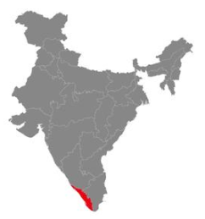
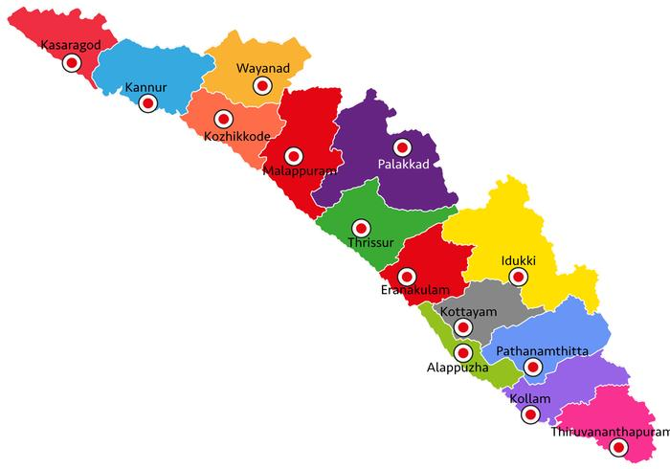
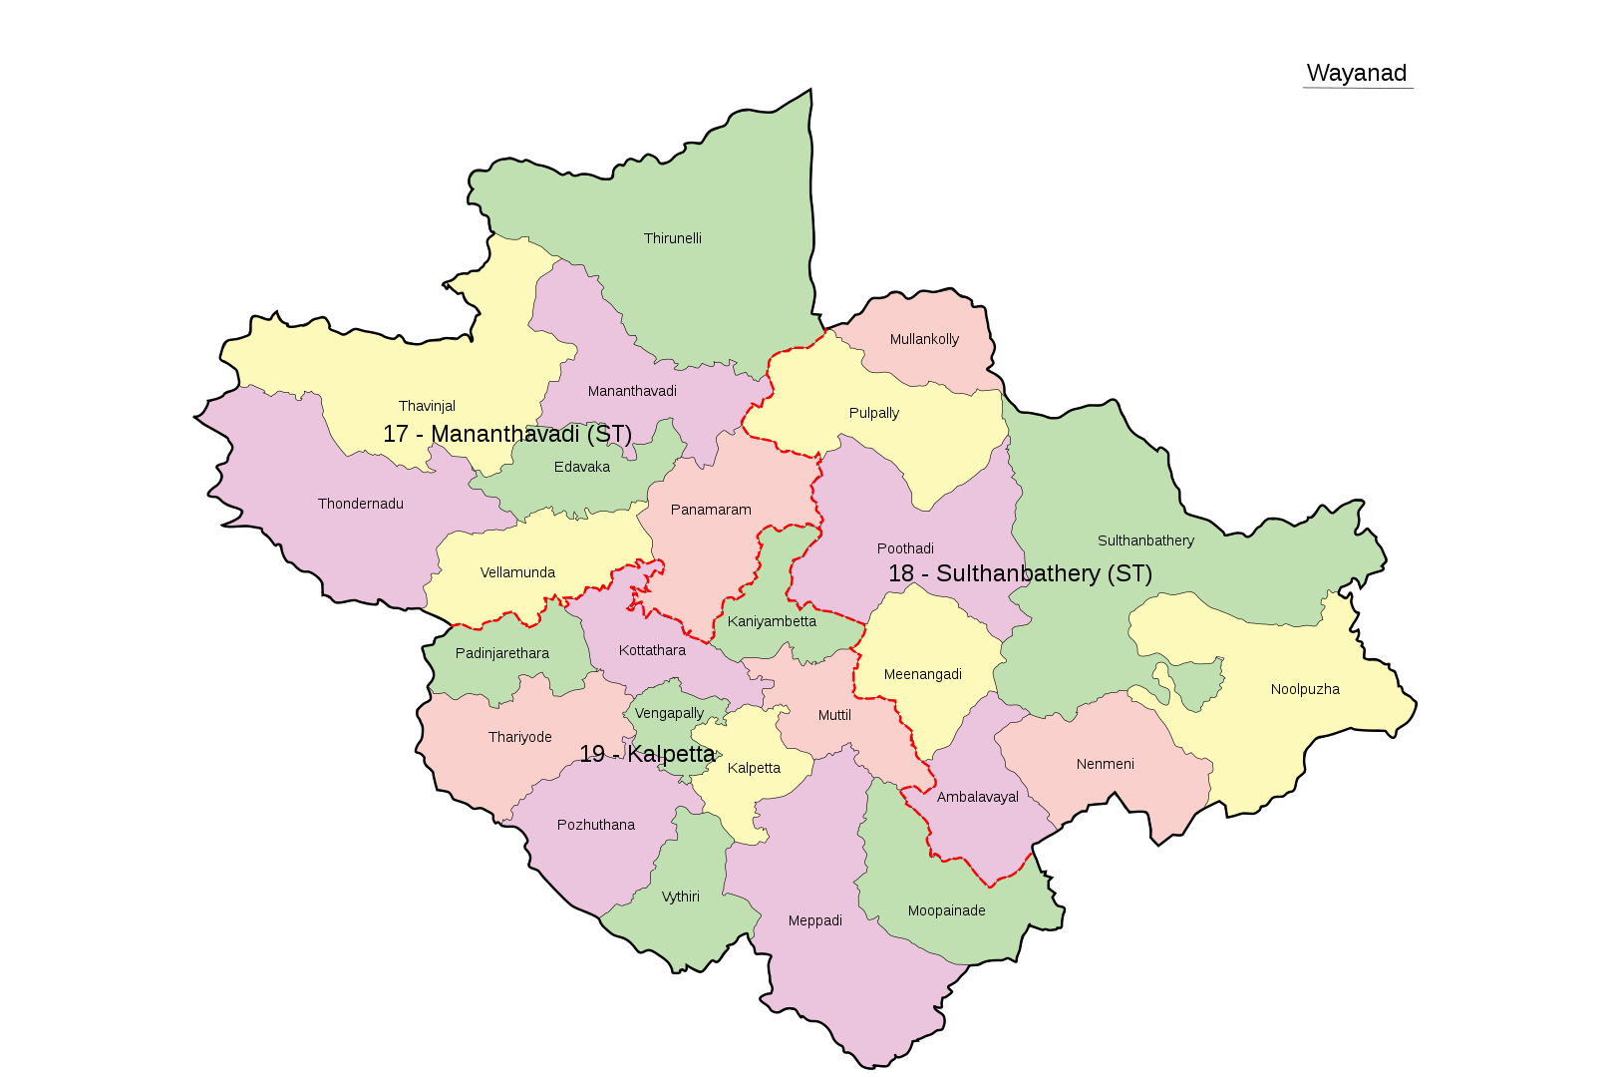
Map of Meenangadi Gram Panchayat
Meenangadi
WAYANAD DISTRICT

Slide 18
Meenangadi Panchayat Profile
Meenangadi is one of the 25 Gram Panchayats in the Wayanad district of Kerala.
Meenangadi is located is classified as “highly vulnerable to climate change”.
A geographical area of 53.52 Sq. Km with rocky hilly area, valley and plains.
A few portions of the Meenangadi falls under the rain-shadow.
The district is situated on the eastern slope of the Western Ghats.

Slide 19
Meenangadi Panchayat Profile
Demographic Profile of Meenangadi Gram Panchayat

Slide 20
Meenangadi Panchayat Profile
Occupational Profile of Meenangadi Gram Panchayat

Slide 21
Meenangadi Panchayat Profile
Areas Under Cultivation in Meenangadi Gram Panchayat

Slide 22
Meenangadi Panchayat Profile
Perennial crops Cultivation in Meenangadi Gram Panchayat

Slide 23
Meenangadi Panchayat Profile
Seasonal Crops Cultivation in Meenangadi Gram Panchayat

Slide 24
Timeline of Carbon Neutral Project in Meenangadi
Following the Paris Climate Agreement, the Gram Panchayats launched a pilot project called “Carbon -Neutral Meenangadi”.
Launched on June 5, 2016.
The Gram Panchayat had set a 5 year target for the village to achieve Carbon-Neutral status.
The initial aim was to turn Meenangadi, into the country’s first Carbon-Neutral Panchayat by 2020.
However, Covid 19 pandemic led to delay in realizing it
At present, Meenagadi is inching closer towards carbon- neutrality.

Slide 25
Timeline of Carbon Neutral Project in Meenangadi
In order to achieve carbon neutrality, the Meenangadi Gram Panchayat has to offset about 15,000 tonnes of carbon by 2020.
The primary aim is to reduce carbon production and emission by bringing down pollution, eliminating plastic waste and expanding the green cover of the Meenangadi Panchayat.
As a first step the concerned stakeholders conducted soil and energy consumption audits by assessing each and every house.

Slide 26
Stakeholders
Meenangadi Gram Panchayat and Government of Kerala.
The carbon – neutral project is implemented with the support of :
Thanal, environmental advocacy group.
M S Swaminathan Research Foundation’s Community Agro biodiversity Centre.
Academy of Climate Change Education and Research (ACER) under Kerala Agricultural University and Zoology department of University of Kannur.
Collaboration with multiple stakeholders is mandatory to realize the dream of carbon-neutrality as is evident in the case of Meenangadi.

Slide 27
Relevance of Carbon Neutral Meenangadi
Deforestation has been rampant in Wayanad in the last three decades and the district is identified as a vulnerable climate change hotspot by the State Action Plan on Climate Change (SAPCC).
Tackling climate change is a task that needs to happens from the bottom up. Villages like Meenangadi can serve as positive role models in this regard.

Slide 28
What Meenangadi Panchayat did?
In 2016, the Panchayat planted trees on some 38 acres of land. These include 450,000 coffee plants, 32,500 cardamom trees, and over 20,000 other shade trees, including neem and coconut, all of which were provided to villagers for free.
Using MGNREGS funds, Gram Panchayat have planted 10,000 saplings on 32 acres of Devaswom land in Meenangadi.
Conducted a carbon emission and sequestration analysis in transportation, energy, waste, livestock and AFOLU
A study on carbon emission and sequestration in the Meenangadi Gram Panchayat limits has found that the carbon sequestration level is 11,452 tonnes lower than the carbon emission in the Gram Panchayat. (Study by Thanal)

Slide 29
What Meenangadi Panchayat did?
A forest survey was also conducted to count the number of trees in Meenangadi.
A wood-based crematorium in the Meenanagadi village now runs on Compressed Natural Gas (CNG).
A plastic shredding unit has been set up in Meenangadi and use the shredded plastic for tarring roads.

Slide 30
What’s in Store for the Future?
As it is primarily an agrarian village adding a carbon neutral tag for local products can transform the rural economy and the livelihood of farmers.
A ‘carbon neutral’ tag for the pepper, coffee and organic vegetables cultivated in Meenangadi will have a lot of demand and thus it will fetch its farmers’ high prices and global attention.

Slide 31
What’s in Store for the Future?
Already attempt has been made to embrace Carbon-Neutrality for the entire Panchayat in Kerala.
It also says that the Carbon -Neutral project will be adopted by the state as a whole and the Wayanad district will be evolved as a role model in this regard.
Meenangadi is setting up a carbon neutral learning lab for effective knowledge sharing.
The carbon-neutral learning lab will have training facilities and a demonstration of the technical and scientific aspects of the Carbon Neutral Meenangadi project.

Slide 32
What’s in Store for the Future?
Union Ministry of Panchayati Raj highlighted the 'Carbon Neutral Meenangadi' project as a model that can be replicated in all states (Raghunath, 2024).

Slide 33
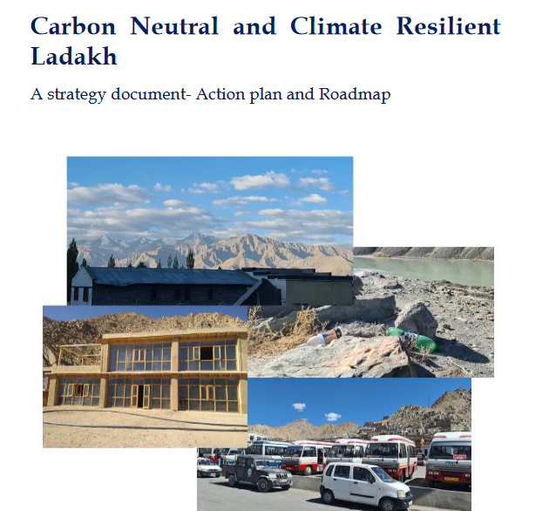
Carbon Neutral Villages – The Ladakh Way

Slide 34
Carbon Neutral Villages – The Ladakh Way
The Union Territory of Ladakh, one of the least populated UTs in India, is also going the carbon–neutral way.
The decision to develop Ladakh, Leh and Kargil into carbon–neutral regions was announced by Prime Minister Narendra Modi on August 16, 2020 (Nandi 2020).
The construction of a 7500 MW solar park is underway in Ladakh.
The Leh airport in Ladakh is being built as a carbon-neutral airport.
Meanwhile Ladakh also functions as a natural carbon sink as the agroforestry sector in Ladakh including the Nubra Valley filled with 575,000 plantations of willow and poplar trees has the potential to sequester 75,000 tonnes of carbon (Kumar et al. 2009) and along with that the locals have been engaged in the cultivation of climate-resilient crops for years.

Slide 35
Other Carbon Neutrality Initiatives in India
Carbon-neutral airports in India
Indira Gandhi International Airport, Delhi (runs completely on solar and hydropower)
Cochin International Airport, Kerala (Since 2015, the International Airport runs completely on solar power)
Kempegowda International Airport, Bengaluru (net energy neutral status, onsite solar installations as well as power purchase agreements from solar and wind energy suppliers)
Chhatrapati Shivaji Maharaj International Airport, Mumbai (received Level 4+ Carbon Neutrality certification by Airports Council International)
Kushok Bakula Rimpochee Airport, Leh (A geothermal system, along with a solar plant, will be used for the new airport terminal building)
Biju Patnaik Airport, Odisha (LED lights, energy-efficient terminal, a solar power plant, wastewater management)

Slide 36
Other Carbon Neutrality Initiatives in India
Delhi, Mumbai, Hyderabad and Bengaluru have achieved Level 4+ carbon neutrality certification. Additionally, 66 Indian Airports are operating on 100% Green Energy (Press Information Bureau, December 4, 2023).
Encouragement for Agroforestry in Kerala and other states.
An agroforestry farm is believed to sequester carbon better because of its greater capacity to capture and utilise water, sunlight and nutrients than a single-species crop.
A Seed Farm in Aluva in Kochi, Kerala has become the first seed farm in the country to achieve carbon neutral status.
India's first carbon-neutral organic seed farm in Kerala's Aluva is a role model for farmers in a world threatened by global warming (Jacob, 2024).
Over 250 universities in India are in the process of developing roadmaps to achieve carbon-neutrality in their campuses . Leading the way, Indian Institute of Technology (IIT), Delhi to reduce its carbon footprint by 50 per cent.

Slide 37

Jos Chathukulam
Director
Centre for Rural Management (CRM)
Kottayam , Kerala (India), email: joschathukulam@gmail.com

