Slide 1
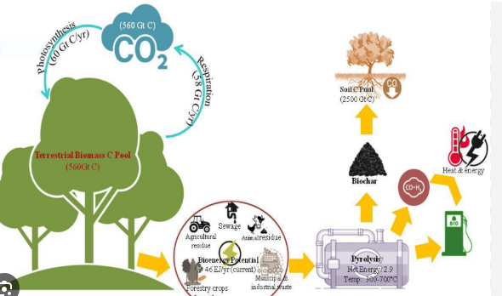
Implementation of Carbon Neutrality, Setting Targets Through Localizing Sustainable Development Goals
Jos Chathukulam
Director
Centre for Rural Management (CRM)
Kottayam , Kerala (India), email: joschathukulam@gmail.com
Presented in the Two Day Training on Strategies for Planning and Implementation of Carbon Neutral Villages and Empowering Rural Woman through SHGs held on 19 & 20 February 2024 organized by Directorate of Rural Development and Panchayati Raj, Govt. of Manipur.

Slide 2
SDGs & India
SDGs are prescribed as the answer to address the development challenges in various countries including India.
India is a signatory of SDGs 2030 and has offered its strong commitment.
Flagship Programmes and National Development Goals are reflected in SDGs.
For instance, the flagship programs of the Government of India such as National Nutrition Mission, National Health Protection Scheme, Care for the Girl Child, and Aspirational Districts Programme have the potential to address the challenges highlighted by SDGs. Then centrally sponsored schemes including MGNREGS are directly or indirectly aligned with SDGs.
Moreover, the ‘Sabka Saath, Sabka Vikas, Sabka Vishwas’, mirror the essence of the 2030 Agenda for Sustainable Development.
With the Principle of Cooperative Federalism, the states are the primary stakeholders in ensuring the success of localization of SDGs
Localization of SDGs is of central importance in ensuring the success of carbon neutrality initiatives. For this, the SDG goals need to be translated into policies at local level.

Slide 3
Attempts to Localize SDGs in India A.The Attempts by NITI Aayog in Localizing SDGs
NITI Aayog is the ‘Nodal Agency’ for coordinating and monitoring the SDGs in India.
NITI Aayog periodically conducts reviews on SDG adoption and reaches out to the States and UTs.
In 2018, NITI Aayog released SDG India Index: Baseline Report 2018.
“The SDG India Index” is a single measurable Index to map progress of States & UTs towards 2030 SDGs. It documents the progress made by the States and UTs towards implementing the 2030 SDG targets.
In 2019, NITI Aayog published a report on Localizing SDGs, Early Lessons from 2019.

Slide 4
Attempts to Localize SDGs in India
A Critique of NITI Aayog’s Approach in Localizing of SDGs
For NITI Aayog, ‘localization’ in terms of SDGs refer to as a “process of recognising sub-national contexts.
NITI Aayog asserts that sub-national governments especially those at State play an important role.
Based on the SDG India Index: Baseline Report 2018 and the Localizing SDGs, Early Lessons from 2019, NITI Aayog’s focus on localization is limited to States/ UTs and to some extent at the district level. It only offers limited attention on the significance of localization of SDGs at grassroots level.
No evaluation and assessment on the present status and performance of localizing SDGs at the grassroots level has been attempted.
There are only passive references to localization of SDGs at Grassroots Level involving Local Governments .
NITI Aayog’s focus is largely on sub-national governments rather than Local Governments.

Slide 5
Attempts to Localize SDGs in India The Attempts by the MoPR in Localizing SDGs
Empowering Local Governments is one of the solid strategies for ensuring community ownership, integration and localization of SDGs at grassroots level, primarily due to the fact that the members are directly elected by the people, and are mandated to undertake planning exercise for “social justice and local economic development” in consultation with the people.
29 Subjects that are assigned to Gram Panchayats cover the SDGs.
Many of the SDG targets are within the purview of these functions listed in the 11thSchedule.
There are also the various flagship programmes such as Swachh Bharat Abhiyan and Jan Dhan Yojana which are at the core of the SDGs. Local governments play a pivotal role in many of these programmes.
MoPR has been advocating to integrate SDGs with GPDP and have started to prepare guidelines to support this integration.

Slide 6
Attempts to Localize SDGs in India The Attempts by the MoPR in Localizing SDGs
The GPDPs are prepared in a participatory manner and needs to be approved by the Gram Sabhas. Thus, integrating SDGs into GPDP is an important step in localizing SDGs at the grassroots level.
The GPDP process supported by the MoPR has created conducive conditions for the Gram Panchayats to integrate SDGs into development action .
MoPR is committed to the achievement of SDG goals through Rashtriya Gram Swaraj Abhiyan (RGSA).

Slide 7
Attempts to Localize SDGs in India The Attempts by the MoPR in Localizing SDGs
Among the 17 SDGs, MoPR has identified 13 Goals where it could intervene at the grassroots level. Those selected SDGs are:
Goal 1 – NO POVERTY
Goal 2 - ZERO HUNGER
Goal 3 - GOOD HEALTH AND WELL BEING
Goal 4 - QUALITY EDUCATION
Goal 5 - GENDER EQUALITY
Goal 6 - CLEAN WATER AND SANITATION
Goal 7 - CLEAN AND AFFORDABLE ENERGY
Goal 8 - DECENT WORK AND ECONOMIC GROWTH
Goal 10 - REDUCED INEQUALITIES
Goal 13 - CLIMATE ACTION
Goal 14 - LIFE BELOW WATER
Goal 15 - LIFE ON LAND
GOAL 16 - PEACE JUSTICE AND STRONG INSTITUTION

Slide 8
Attempts to Localize SDGs in India The Attempts by the MoPR in Localizing SDGs
MoPR has constituted an Expert Group in 2020 to provide recommendations and way forward for localizing SDGs through PRIs.
The Expert Group has prepared a Report on Localization of SDGs in PRIs.
It acts as a blueprint to understand how SDGs can be localized to engage PRIs .
It provides a framework for ‘localizing’ the implementation of SDGs through capacitating local governments.
The Report aims at empowering local governments to plan, monitor and implement SDGs.

Slide 9
Attempts to Localize SDGs in Kerala Capacity Building for Localizing SDGs by KILA
KILA has been undertaking CB&T for multiple stakeholders on SDGs by including a module on SDGs on ‘Social Education Programme’.
KILA, has been designated as the CB&T partner on SDGs and has setup the ‘Centre for SDGs and Local Governments’. It has prepared a draft Local Indicator Framework (LIF) incorporating 16 SDGs and its Sub-Indicators.
KILA has prepared an Online Dashboard, on the attainment of SDGs.
KILA has developed SDG Training Tool Kit for setting targets and monitoring SDGs that enable the functionaries at district and sub-district levels to track and monitor the progress on SDGs.

Slide 10
Attempts to Localize SDGs in Kerala Localizing SDGs and 25 Years of Experience in Planning and Decentralization (PPC)
Kerala which has 25 years of experience in planning and decentralization affords the best opportunity for Localizing SDGs.

Slide 11
Localizing SDGs with Specific Emphasis to Carbon Neutrality
Discussing case studies on localizing SDGs in 2 Gram Panchayats in Kerala – Chelakkara GP in Thrissur district and Nellanad GP in Thiruvanthapuram district.
Examines the experimentations undertaken in localizing SDGs in these 2 GPs from a theoretical perspective of Gandhi-Kumarappa framework on the political economy of development and environment.

Slide 12
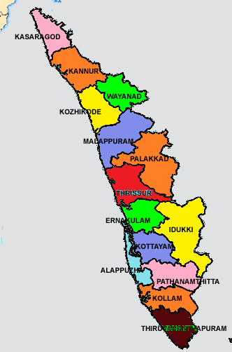
Localizing SDGs and The Case of 2 GPs in Kerala
Case Studies
Chelakkara GP
Nellanad GP

Slide 13
Nellanad Gram Panchayat
Basic Statistics
Total Population | 26000
No. of Elected Functionaries | 16
Households | 6585
Head of the Panchayat | Women
OSR (2021-2022) | Rs 1.9 Crore
Receipts (2021-22) | Rs.16.34 Crore
Payments (2021-22) | Rs.10.89 Crore
Total Projects (2022-23) | 154
Plan Size (2022-23) | Rs.12.03 Crore
Present Political Regime | Congress (UDF Coalition)

Slide 14
Linking with the SDGs
Organized workshops, consultations, training, awareness programmes , campaigns for the office bearers and elected functionaries and local citizens.
KILA has provided full support and mentoring .
Local Indicator Framework (LIF) has operationalized.
Has formulated a new vision for preparing the targets and linking with the SDGs.
Prepared a vision document to implement 6 key programmes in tune with the SDGs with a common tagline - Nellanad Nalla Nadu ( Nellanad – a Land of Wellbeing)&No such tagline for Chelakkara GP.

Slide 15
Nellanad Gram Panchayat
Programme I- Malinya Muktha Nellanad
(Solid Waste and Liquid Waste Free
Nellanad)
SDG 6 and SDG 13 are closely linked to carbon-neutrality

Slide 16
Nellanad Gram Panchayat
Programme II- (Comprehensive Watershed
Development)

Slide 17
Nellanad Gram Panchayat
Programme III-VIDYA VELICHAM (Enlightenment through Education)

Slide 18
Nellanad Gram Panchayat
Programme IVa- Panchayat Level Sahitya Academy-(Literary & Cultural Forum)

Slide 19
Nellanad Gram Panchayat
Programme IVb- Panchayat Sports Council

Slide 20
Nellanad Gram Panchayat
Programme V- Labour Hub- (An
Employment Platform)

Slide 21
Nellanad Gram Panchayat
Programme VI- THANAL-(Shadow
for Senior Citizens)

Slide 22
Chelakkara Gram Panchayat
Basic Statistics
Total Population | 44389
No. of Elected Functionaries | 22
Households | 11115
Head of the Panchayat | Women
OSR (2020-21) | Rs.1.54 Crores
Receipts(2020-21) | Rs.14.85 Crore
Payments (2020-21) | Rs.7.47 Crore
Total Projects (2022-23) | 154
Plan Size (2022-23) | Rs.13.50 Crore
Present Political Regime (2022-23) | CPI(M) (LDF Coalition)

Slide 23
Chelakkara Gram Panchayat
Programme I- Health for All

Slide 24
Chelakkara Gram Panchayat
Programme II- Energy for Solar Panel
Here SDG 7 and SDG 13 are closely linked to carbon neutrality

Slide 25
Chelakkara Gram Panchayat
Programme III- Malinya Muktha Chelakkara
(‘Solid & Liquide Waste Free Chelakkara’)

Slide 26
Chelakkara Gram Panchayat
Programme IV- Fitness Centre for Women

Slide 27
Chelakkara Gram Panchayat
Programme V- Mini Industrial Estate

Slide 28
Chelakkara Gram Panchayat
Programme VI- Child Friendly Panchayat

Slide 29
Chelakkara Gram Panchayat
Programme VII- Protection of Water Bodies

Slide 30
NET ZERO CARBON –SAMPLE SURVEY FORM
Net Zero Carbon
Survey Form-1
Government/Semi-Government, Public Institutions, Co-Operative Institutions
Serial number
Date
Name of the District
Name of the local Government
Type of the local Government | Gram Panchayat, Municipality, Municipal Corporation
Name and Number of the Ward/Division

Slide 31
NET ZERO CARBON –SAMPLE SURVEY FORM
Net Zero Carbon
Survey Forum Form-1
1. General Information of the Institution
Name of the Institutions
Post Office, Pin Code
Type of Activity
Number of Employees
Area | Building Area(Meter Squre)
 | Area of the Land (In Cent)
Total Number of Buildings

Slide 32
NET ZERO CARBON –SAMPLE SURVEY FORM
Net Zero Carbon
Survey Forum Form-1
2. Energy
KSEBL Consumer No.
Last Electricity Bill (If last bimonthly bill available)
Last bimonthly bill (In Rs)
Is there a solar Plant | Yes/No
If yes, Capacity of the Plant (Kw)

Slide 33
NET ZERO CARBON –SAMPLE SURVEY FORM
Net Zero Carbon
Survey Form-1
3. Information on the Other Sources of Energy
Use of Fire Wood per month (Kg) |  | Use of Bio gas per month ( hour)
Use of LPG per month(Number of Cylinder) |  | Use of induction cooker per month (hour)
Any Other |  | Any Other

Slide 34
NET ZERO CARBON –SAMPLE SURVEY FORM
Net Zero Carbon
Survey Form-1
a. Bulbs/Tube lights
No. | Type | Capacity(watt) | Daily use time(hour)

Slide 35
NET ZERO CARBON –SAMPLE SURVEY FORM
Net Zero Carbon
Survey Form-1
b. Fan
No. | Type | Capacity(watt) | Daily use time(hour)

Slide 36
NET ZERO CARBON –SAMPLE SURVEY FORM
Net Zero Carbon
Survey Form-1
c. Refrigerator
No. | Type | Capacity(watt) | Daily use time(hour)

Slide 37
NET ZERO CARBON –SAMPLE SURVEY FORM
Net Zero Carbon
Survey Form-1
d. Air Condition
No. | Type | Capacity(watt) | Daily use time(hour)

Slide 38
NET ZERO CARBON –SAMPLE SURVEY FORM
Net Zero Carbon
Survey Form-1
e. Other Instruments
No. | Type | Capacity(watt) | Daily use time(hour)

Slide 39
NET ZERO CARBON –SAMPLE SURVEY FORM
Net Zero Carbon - Survey Form-1
4.Waste
Does garbage/waste pile up within the institutional premises? | Yes No
Is there a landfill site? If yes, please specify the size of the area used as a landfill (in Cents)
Average height of the waste deposit (in centimeters)
Have you come across incidents where the dumped waste was found burned?
Is there a bio gas plant? If yes, please specify the quantity of waste deposited per day

Slide 40
NET ZERO CARBON –SAMPLE SURVEY FORM
Net Zero Carbon
Survey Form-1
a. Information on type of waste and waste treatment/processing methods
Type | Waste per day (Kilogram) | Processing method
Organic |  | Dumped
 |  | Composting
 |  | Converted into Bio gas
Non organic |  | Burning
 |  | Dumped
 |  | Segregate

Slide 41
NET ZERO CARBON –SAMPLE SURVEY FORM
Net Zero Carbon Survey - Form-1
5. Water Consumption
Have you noticed wastage/leakage of water from taps/pipes? | Yes No
Have you noticed any leaks in taps and water supply systems? | Yes No
Overhead water tank Capacity(Liter)
Method of filling the water(Use tick mark) | Municipal water fills the overhead tank
 | Well/Bore well/ Pumping from the lower tank
Pump Capacity (HP)
If using municipal water | Bimonthly usage (kilo liter)
 | Bimonthly water bill (in Rs)
Tank filling time (Minute)
Daily water usage(Liter)

Slide 42
NET ZERO CARBON –SAMPLE SURVEY FORM
Net Zero Carbon Survey - Form-1
5. Transportation
a. Does your institution have its own vehicle? Yes No
b. If Yes, please specify the details on the vehicle
Details of the Vehicle |  | Information on fuel used
Sl No. | Type of vehicle | Diesel |  | Petrol |  | CNG |  | Electricity
 |  | No. | Average quantity of fuel used per month(Litre) | No. | Average quantity of fuel used per month(Litre) | No. | Average quantity of fuel used per month(Kg) | No. | Average distance traveled per month (Km

Slide 43
NET ZERO CARBON –SAMPLE SURVEY FORM
Net Zero Carbon Survey - Form-1
c. Information Regarding Vehicles Used by Employees
Details of the Vehicle |  | Information on fuel used
Sl No. | Type of vehicle | Diesel |  | Petrol |  | CNG |  | Electricity
 |  | No. | Average quantity of fuel used per month(Litre) | No. | Average quantity of fuel used per month(Litre) | No. | Average quantity of fuel used per month(Kg) | No. | Average distance traveled per month (Km)

Slide 44
NET ZERO CARBON –SAMPLE SURVEY FORM
Net Zero Carbon Survey - Form-1
6. Agriculture
Do you have any type of farming or cultivation on the Institute premises?
Yes No
If Yes, please provide the details below
Details of location (Wetland, Terrace, dry land) | Area (Cent) | Cultivated crops | Quantity of fertilizer used (in kg for a year)
 |  |  | Fertilizer | Organic fertilizer

Slide 45
NET ZERO CARBON –SAMPLE SURVEY FORM
Net Zero Carbon Survey - Form-1
7. Other Details
Any Green Spaces/Corners established in your Institution | Yes No
If Yes, please specify, the area allocated for the green spaces?
Total number of plants
When was the Green Spaces established?
Is there a garden? | Yes No
Area of the Garden (Cent)
Is there agricultural land? | Yes No

Slide 46
NET ZERO CARBON – EMISSION ESTIMATION SURVEY FORM
Public Places
Serial number
Date
Name of the District
Name of the local Government
Type of the local Government | Gram Panchayat, Municipality, Municipal Corporation
Name and Number of the Ward/Division

Slide 47
NET ZERO CARBON – EMISSION ESTIMATION SURVEY FORM
1. Agriculture (Paddy Fields)
Name of the Place
Land Mark
Ownership of agricultural land | Private, Government/Public Sector, Co-Operative
Name of the Owner
Type of Land | Wet Land Dry Land
Total area of the Land(Cent)
Area of ​​land under cultivation
Area of ​​cultivable fallow land
How many years the land has been barren?

Slide 48
NET ZERO CARBON – EMISSION ESTIMATION SURVEY FORM
1. (a) Details of the crop cultivated
Crop | Area(Cent) | Cultivation Period | Fertilization method |  |  | Pest control method
 |  |  | Fully agro-farming | Fully chemical fertilizer | Application of mixed fertilizer | Organic pest control method | Chemical pest control method
Paddy
Have you noticed any incidents were garbage/waste was dumped on agricultural land? | Yes No
Is there any landfill? If yes, please give the details regarding its area (in Cents)
Average height of the waste deposit /dumped waste (in Centimeters)
Have you come across any incidents where crop residuals were burned?

Slide 49
NET ZERO CARBON – EMISSION ESTIMATION SURVEY FORM
2. Waste Disposal Centers
Place
Total Area of the Waste Disposal Centers (in Cents)
Average Height of the deposited Waste (In Centimeters)
Type of waste deposited | Organic Non-Organic Not Segregated segregate
2 (a). Quantity of the Waste Generated and Waste Treatment Method
Type | Waste per day(Kilogram) | Processing method
Organic |  | Dumped
 |  | Composting
 |  | Converted into Bio gas
Non organic |  | Burning
 |  | Dumped
 |  | Segregate

Slide 50
NET ZERO CARBON – EMISSION ESTIMATION SURVEY FORM
3. Bus Auto Taxi Other Vehicle (………………………………..) Stand
Name of the place where the Bus/Auto/Taxi stand is located
3. (a). Type of Vehicles and Fuels Used
Details of the Vehicle |  | Information on fuel used
Sl No. | Type of vehicle | Diesel |  | Petrol |  | CNG |  | Electricity
 |  | No. | Average quantity of fuel used per month(Litre) | No. | Average quantity of fuel used per month(Litre) | No. | Average quantity of fuel used per month(Kg) | No. | Average distance traveled per month (Km

Slide 51
NET ZERO CARBON – EMISSION ESTIMATION SURVEY FORM
4. Market
Name of the Place
Area
4 (a). Details regarding quantities of waste generated and waste treatment methods
Type | Waste per day(Kilogram) | Processing method
Organic |  | Dumped
 |  | Composting
 |  | Converted into Bio gas
Non organic |  | Burning
 |  | Dumped
 |  | Segregate

Slide 52
Challenges in Localizing SDGs at Grassroots level in Kerala
There are many conceptional and operational issues on “Localizing SDGs at Grassroots”.
Elected functionaries at the grassroots level and other rural stakeholders have not been able to fully internalize the SDGs in general.
Capacity deficit in using available secondary data from different sources.
Lack of quantitative and qualitative data in terms of SDGs at the local level.
Lack of proper measurement framework for quantifying SDGs at the local level.
Lack of support from local bureaucry (within the GP and out side the GP).
Deficit in vernacular literature on SDG and related concepts.
Deficit in expertise (both academic and praxis domains) on the subject on localizing SDGs at Grassroots.
Serious methodological issues of aggregation and disaggregation of SDGs.

Slide 53
Conclusion
The experimentations in localizing SDGs in these 2 GPs (and many cases all over the country) have the feasibility of scaling up this model across India.
The experimentations in localizing SDGs in these cases have some theoretical perspective of Gandhi-Kumarappa Framework on Political Economy of Development and Environment.
Localization of SDGs at the Grassroots through Local Governments in an affordable and speedy manner may be possible if there is a proper convergence of SDGs with the annual Mission Antyodaya Survey ,GPDP, Grants from Union and State Finance Commissions and Flagship Programmes.

Slide 54
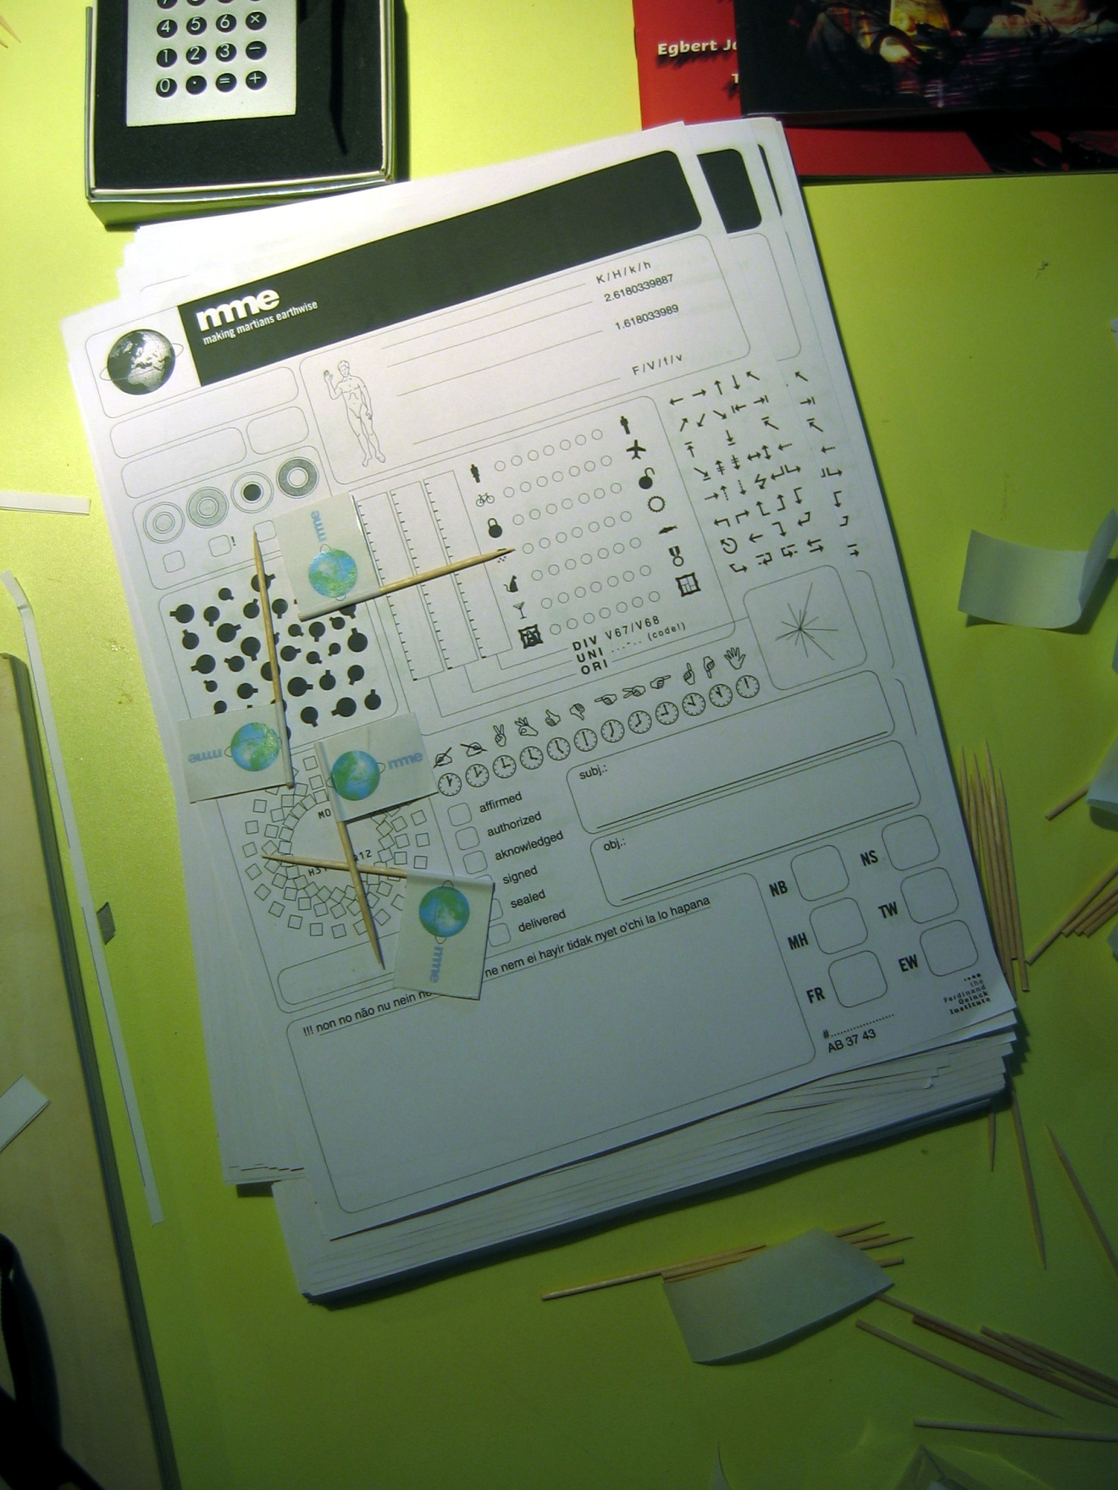
THANK YOU
Jos Chathukulam
Director
Centre for Rural Management (CRM)
Kottayam , Kerala (India), email: joschathukulam@gmail.com

Slide 55
Conclusion
Back

