Slide 1
Backsliding of Democracy and Decentralization in Kerala (India)
Jos Chathukulam
Director
Centre for Rural Management (CRM)
Kottayam, Kerala (India)
Presented at the CASID Conference 2024, Montreal, Canada on June 12-14, 2024

Slide 2
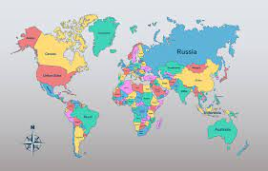
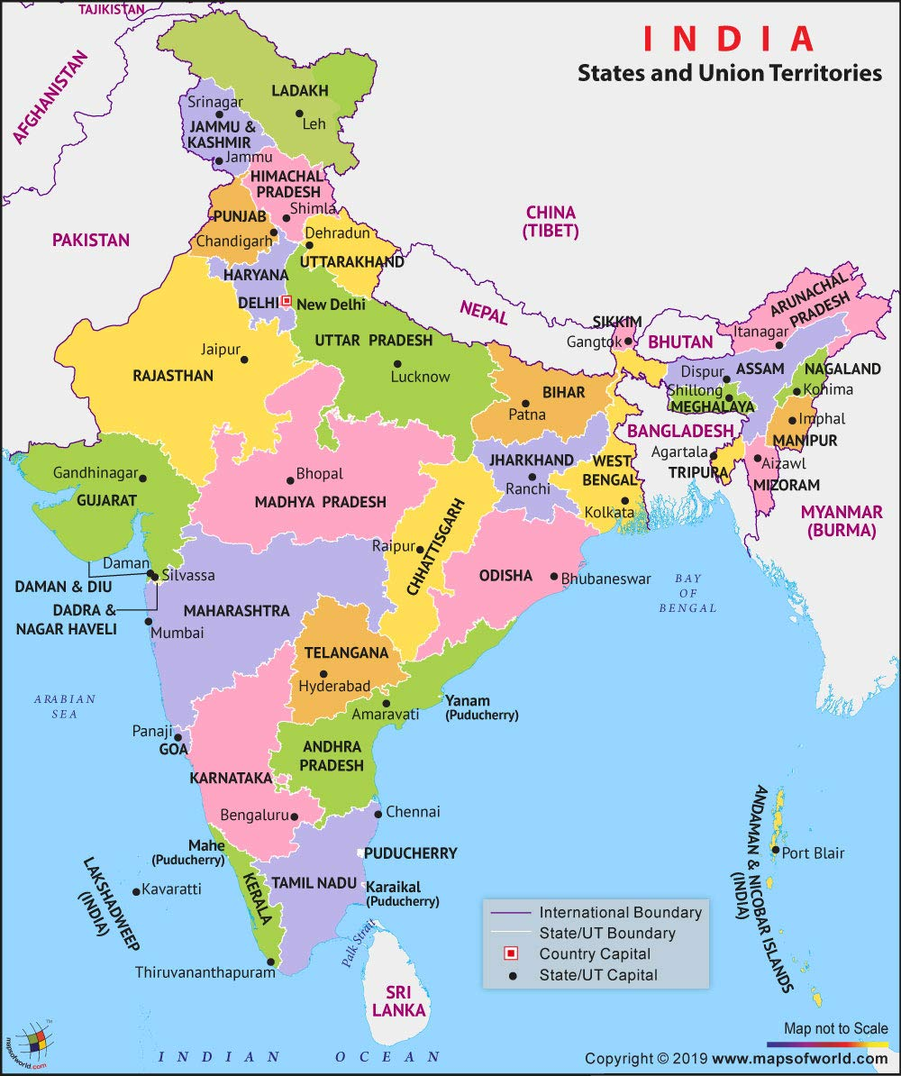
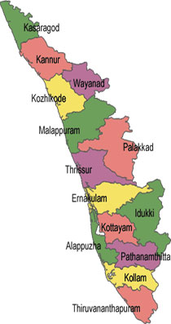
Framework
While there has been plethora of literature on ‘Kerala Model of Development and Decentralization’, there is no serious discussions on the status of democracy in the state. Whether Kerala has a vibrant democracy equivalent to its well-known ‘Kerala Model of Development’ ?
Concepts discussed in Nancy Bermeo’s article titled On Democratic Backsliding (2026) and Democratic Backsliding in Africa (2023), a book edited by Leonardo R. Arriola, Lise Rakner, and Nicolas van de Walle have been applied to examine the backsliding of democracy and decentralization in Kerala, a state (province) in India.

Slide 3
Reasons for Backsliding of Democracy and Decentralization in Kerala
Political Hegemony of the present Left Democratic Front (LDF) Regime in Kerala on Civil Societies, Public Sphere, Local Governments and all other Spheres and Domains.
Political Clientelism.
Political Violence including political killings sponsored by political parties.
‘Party –Society’
Money and Muscle Power
Nepotism and Backdoor Appointment of Party Loyalists (Patronage/ Spoils System).
Corruption from ‘top to bottom’.
Rise of ‘Strongman Politics/Authoritarian Populism’
Disempowered Local Governments & Citizens

Slide 4
A Brief Profile of Kerala
Kerala state was formed on November 1, 1956.
Kerala is located in the Southwestern India, bounded by Western Ghats on the East and Arabian Sea on the West.
According to 2011 Census of India, the population of Kerala was 33,406,061, that is 2.76 per cent of India's population.
Population density – 859/sq.km.
Literacy Rate – 94 per cent.

Slide 5
Development Profile of Kerala
Kerala has been celebrated as a unique development model by scholars across the world for its exemplary achievements in human development and poverty reduction despite relatively low GDP growth (Franke & Chasin, 1994; Kannan, 2000; Tornquist,2002l; Chathukulam & Tharamangalam, 2020).
In 2022-23, the GSDP at constant prices recorded a positive growth of 6.6 % (Kerala Economic Review, 2023).
Kerala has performed the best among the States of India with respect to the NITI Aayog’s Multidimensional Poverty Index, 2023 (the score was 0.002 %).
Kerala has continually ranked first in the last three editions of NITI Aayog’s SDGs Index (Kerala Economic Review, 2023).
Kerala has the highest rank in India on HDI on par with developed countries.

Slide 6
A Brief Political Profile of Kerala
The political landscape and equations in Kerala have puzzled political scientists across the world.
In the late 1950s, Kerala , (a Province in Federal India) got its first elected Communist government
The was the first democratically elected government coming to power in the world.
Many attributed the victory to the support of the Communist Party
Enjoyed the support of peasants and working class due to party’s anti – feudal, ant -imperialist struggles.
The Communist Government was toppled by the ‘Liberation Struggle’
Kerala embraced alternatively in every five years by two coalitions: Left Democratic Front (LDF) and United Democratic Front (UDF).

Slide 7
Political Legacy and Hegemony of LDF over ‘Kerala Model of Development’ and ‘Kerala Model of Decentralization’
Documented in the writings of Amartya Sen and Jean Dreze (Dreze and Sen, 1989, 1998 and 2002).
The high human development despite low economic growth, robust healthcare system, local governments (People’s Plan Campaign), state-society synergy framework, Kudumbashree (Women’s Agency) are considered as the hallmarks of the Kerala model of development.
The introduction of 1996 People’s Plan Campaign (PPC) was a major contribution of the LDF. PPC has now metamorphosed as LDF in Kerala.
Evidence from Kerala suggests that LDF has used ‘Kerala Model of Development’ and PPC for social & political mobilization.
By incorporating clientelist strategies, the LDF has formulated a new political mantra of ‘hegemonic and non -hegemonic generative politics’ to obtain patronage and thereby to capture state power.
LDF turned the decentralization(PPC) initiatives into instruments of political patronage .

Slide 8
Kudumbashree – A Tool for Leveraging LDF’s Political Patronage
Launched in 1996.
One of the largest women’s self-help group networks in the country.
Involved in the implementation of several development schemes and welfare initiatives aimed at reducing poverty and ensuring sustainable livelihoods .
Kudumbashree is the brain child of LDF and a political entity and a political asset for LDF.
Kudumbashree is viewed as a “pro-left agency”.
Ownership of LDF over PPC and Kudumbashree has helped them to mobilize people and distribute political patronage among them .
LDF started to field ‘women in Kudumbashree’ in local government elections.
Out of the 16,965 Kudumbashree members contested in the local government elections, 7071 got elected.
It now works as a political affiliate/feeder group of the LDF.
Kudumbashree women are forced to participate in party rallies, protests, and party activities and functions.

Slide 9
Political Clientelism by LDF
Political clientelism, a mechanism for expressing political support for their own party (Kitschelt and Wilkinson 2007, Bardhan and Mookherjee, 2020).
The LDF has earned the synonym of being the architects of the development in the state through “clientelism and welfare schemes”.
Clientelism has helped LDF in targeting biases in favor of socio-economic groups exhibiting greater loyalty to political incumbents, more likely to reciprocate with their votes.
It causes politicians to favor short-term recurring transfer programs of public goods. For instance, free food kits distribution to people during the great floods in Kerala, during the pandemic induced lockdown
Clientelism is often “populist and progressive, as elected officials are incentivized to deliver benefits to poorer and more vulnerable socio-economic groups whose votes are ‘cheaper to buy’, “(Bardhan and Mookherjee, 2023).

Slide 10
Political Clientelism by LDF(Cont…)
LDF has managed to use populism and clientelism as “modes of political incorporation” (Mouzelis,1986).
Public conscience in Kerala is that the “LDF stands for care economy” and one of the major reasons for such a perspective is largely because of the welfare measures implemented by the successive LDF government
With the help of clientelism and welfare measures, the LDF got an opportunity to salvage their corruption scandals and scams.
A slew of clientelist and welfare policies over the years have played a crucial role in cementing the consecutive victory of LDF in 2016 and 2021.

Slide 11
Violence and Political Killings
Politics of murder has no place in a democracy
There is no one size fits all definition for the term political killings/murders
Some define it as an “extra-judicial killing” in which political rulers and government authorities deliberately and unlawfully kills their political opponents, whom they perceive as a threat to them or whom they view as an enemy to their party, party ideology, beliefs and concepts.
Some compare political killings to ‘politicide’ (political mass murder) in which a group of people are killed because of their “hierarchical position” or “political opposition” to the regime and dominant groups (Gurr and Harff, 2003).

Slide 12
Violence and Political Killings (Cont…..)
Gruesome political killings and violence are increasing at an alarming rate in Kerala.
Kerala being a politically vibrant state along the adversarial and competitive strategies on political lines have been a hotspot of political killings for decades
Clashes between different parties alone have claimed over 300 lives since 1969 (Jacob, 2016).
According to latest figures available with the state police, a total of 173 political murders happened in Kerala between 2000 and 2016 (Koshy, 2017)
From 2016-2021, a total of 32 political killings were reported in Kerala (Babu, 2022).

Slide 13
Democratic Deficit in Kerala Society and Political Killings
None of the political parties in Kerala can claim the moral high ground in the matter of using murder to settle political scores and reap electoral dividends.
All political parties are active participants and beneficiaries of this endless chain of killings, vengeance and politically motivated violence. This itself shows the widening deficit in democratic principles and ideals within Kerala.
Take into account the cold-blooded political killings in Kerala, anyone can cast a doubt that whether the political parties in Kerala, directly or indirectly found an inspiration in Hannah Arendt’s “banality of evil” thesis to justify the murders and killers.

Slide 14
Democratic Deficit in Kerala Society and Political Killings (Cont…)
Political killings in Kerala are a stain on the progressive politics and social harmony in the state.
While Kerala model of development has made the state a unique example in the trajectory of economic and social development, the same cannot be said about the level of democratic approaches in the state.
The political killings and violence in the state points to a widening democratic deficit not only within political and government institutions but also within the Kerala society as a whole.

Slide 15
Student Politics in Kerala and its Role in the Rise of Political Killings in College and University Campuses
Student unions of major and minor political parties are also turning the college campuses into ‘killing fields’ and have become the torchbearers of anti - democratic culture and violence.
The college authorities and students were busy protecting the goons and the police were for the most part reluctant to probe the cases due to fearing (Anand 2024 and Rema, 2024).
Student politics has used wanton violence, social shaming, public trials, smear campaigns, inquisitorial methods and intimidation to sustain its “stranglehold” on college campuses with the support of party leadership (Anand, 2024).
Majority of the government -run colleges in the state are under criminal raj sponsored by student politics.
Criminalisation of campuses is flourishing in the colleges and universities in Kerala and it not only shows the erosion of academic freedom and dignity but also the lack of democratic spaces in the institutions of higher learning.

Slide 16
Party Society
Dwaipan Bhattacharya coined the term “party society” to describe West Bengal's unique history of affiliation to political parties and polarisation along party lines. He coined the term “party society” in this context.
In a party-society, political parties monopolise the social space and suffocate the emergence of civil associations.
Bhattacharya argues that party-society, by either suppressing civil associations or curbing their relevance to government and polity, weakens the negotiating power of disadvantaged groups (Bhattacharya, 2010).
Party Society culture is also true in the case of Kerala. For instance, Communist party’s construction of political allegiance and their persistence of power in the democratic context at a local village level in Kerala has given rise to an empirical phenomenon in Kerala known in popular parlance as ‘party gramam’ or ‘party village’ (Kaul and Kannangara, 2021).

Slide 17
Party Society (Cont…)
In general terms, a ‘party village’ is an administrative unit where a particular political party dominates not simply electorally but in all lived experiences. In other words, Party as an institution mediates every single sphere of social activity (Chatterjee, 2004).
Party Gramams / Villages are mostly found in the North Kerala, and they are much more than standard political strongholds, in terms of how the Communist Party features in people’s lived experiences (Kaul and Kannangara, 2021).
Once a party takes over a village, it enforces an extra judicial power over all the people who live in that village. The party demands unwavering loyalty to the party from each member in the village. In return the parties ensure the benefit of various government schemes to the residents.
Party Society aggravates party dominance over the party villages leading to several electoral malpractices. It has been reported that the parties controlling the party villages were rigging elections by not allowing rival parties to deploy their booth agents in the party villages (Devasia, 2016).

Slide 18
Party Society (Cont…)
Bogus voting is a common practice in party villages in Kerala. Though the election officials are aware of the bogus voting, in the past they were threatened and pressured to turn an unreasoning eye (Shahina, 2012, Devasia, 2016 and Lobo, 2017). It has led to erosion of democratic culture as the right to free and fair elections is often denied here.
Meanwhile, the Election Commission had identified 615 booths in Kannur (a district in the Northern Kerala ) critical and deployed central forces besides employing micro-observers and web cameras in such booths to prevent bogus voting (Devasia, 2016)
In Kerala as in the case of West Bengal has built an “architecture of power that makes extensive political use of governmental resources, allows local party bosses to run their own fiefdom in exchange of total allegiance” (Bhattacharya, 2023).

Slide 19
Money and Muscle power
Out of the sitting MLAs in the Kerala Legislative Assembly, 65 % of them have criminal cases against them (Krishnakumar, 2021).
Party wise sitting MLAs with criminal cases: 51 (91%) out of 56 MLAs from CPI(M), 12 (63%) out of 19 MLAs from CPI, 9 (45%) out of 20 MLAs from INC, 5(28%) out of 18 MLAs from IUML and 4(67%) out of 6 MLAs from Independent have declared criminal cases against themselves in their affidavits (Association of Democratic Reforms, 2021).
Party wise sitting MLAs with serious criminal cases: 18(32%) out of 56 MLAs from CPI(M), 3 (16%) out of 19 MLAs from CPI, 2 (11%) out of 18 MLAs from IUML and 5 (25%) out of 20 MLAs from INC have declared serious criminal cases against themselves in their affidavits.
Out of sitting MLAs in Kerala Assembly analysed, 57(43%) are from high rich categories.
The following MLAs in the respective parties have declared assets valued more than Rs. 10 Million
27% MLAs from CPI(M),
78% MLAs from IUML,
60% MLAs from INC,
100% MLAs from Kerala Congress (M)
The average assets per sitting MLA is Rs. 20.3 million.

Slide 20
Nepotism and Backdoor Appointment of Party Loyalists (Patronage/ Spoils System)
It has been reported that at least 2.5 lakh backdoor appointments took place over almost five years of LDF governance and the beneficiaries were either relatives of party leaders or party sympathisers (Raghunathan, 2021).

Slide 21
Corruption from Top to Bottom Irrespective of Political Parties
Congress-led UDF and the ruling CPI(M)-led LDF in Kerala have always been embroiled in “corruption and scams”. (UDF had solar scam, Bar Bribery while LDF had Gold Smuggling, LIFE Mission Scam, Money Laundering – Karuvannur Bank Scam).
Unholy nexus between business communities and industrialists, religious/community leaders, pressure groups, interest groups, media houses and politicians of all major parties in the State.
The Kochi-based Cochin Minerals and Rutile Limited (CMRL) allegedly made illegal payments to politicians, police officers, media houses, trade unions and others to 'ensure smooth running of business' (Philip, 2023).

Slide 22
Rise of ‘Strongman Politics’ to Authoritarian Populist
The present Chief Minister took charge of Kerala in 2016 with a “strongman image” (double-breasted hero) after leading as the State Secretary of the CPI(M)for 18 years of a major (Bhaskar, 2017).
When the Kerala faced calamities (two unprecedented floods in 2018 and 2019, and during the Covid 19 pandemic), the CM of Kerala got a makeover as a Mass Leader from the Strongman image.
However, the Strongman image and Mass leader makeover faded with corruption and scandals against the CM and his Party became the order of the day
While initially the Strongman image was enough to cover the wrongdoing of the political regime. It has now transformed into an authoritarian populist and a corrupted and disgraced politician.

Slide 23
Disempowered Local Governments/Capturing of Local Governments by the LDF
People’s Plan Campaign (PPC) is considered as a Kerala Model in Decentralization.
The introduction of PPC in Kerala in 1996 is a contribution of the LDF.
PPC spearheaded the devolution of funds, functions and functionaries on one hand,
While decentralization downsizes the state and empowers local governments, the Kerala experience speaks otherwise.
Local governments and its apparatuses have been turned into instruments of political patronage under PPC. It is a state- controlled decentralization.

Slide 24
Disempowered Local Governments/Capturing of Local Governments by the LDF(Cont…..)
In the case of Kerala, it is a state-controlled decentralization and therefore the state did not give the unlimited freedom for local governments in this regard.
The decentralization process was engineered in Kerala in such a way that the state became the major beneficiary of the decentralization initiatives and it empowered the state and disempowered the local governments and faded their independent identity and thus captured the local governments and their apparatus (Chathukulam & John, 2003, Chathukulam and Joseph 2021).

Slide 25
Discussion and Conclusion
It is the need of the hour to serious look into the status of democracy and decentralization in Kerala as a whole.
The Kerala model of development and decentralization should be revisited in the light of flawed democratic framework within the state.
The existing Democracy Index and Freedom Index should also investigate into sub-national and sub-district operationality of democratic principles and values.
How long can a flawed democratic society in Kerala sustain Kerala model of development and decentralization?
In general, how long can a society with poor democratic credentials sustain growth and development?

Slide 26
Jos Chathukulam
Director
Centre for Rural Management (CRM)
Kerala (India)
Email: joschathukulam@gmail.com

