Slide 1
Home Grown Solutions for Sustaining Shared Futures Narratives from Rwanda
Jos Chathukulam
Director
Centre for Rural Management (CRM)
Kerala (India)
Presented at the CASID Conference 2024, Montreal, Canada on June 12-14, 2024

Slide 2
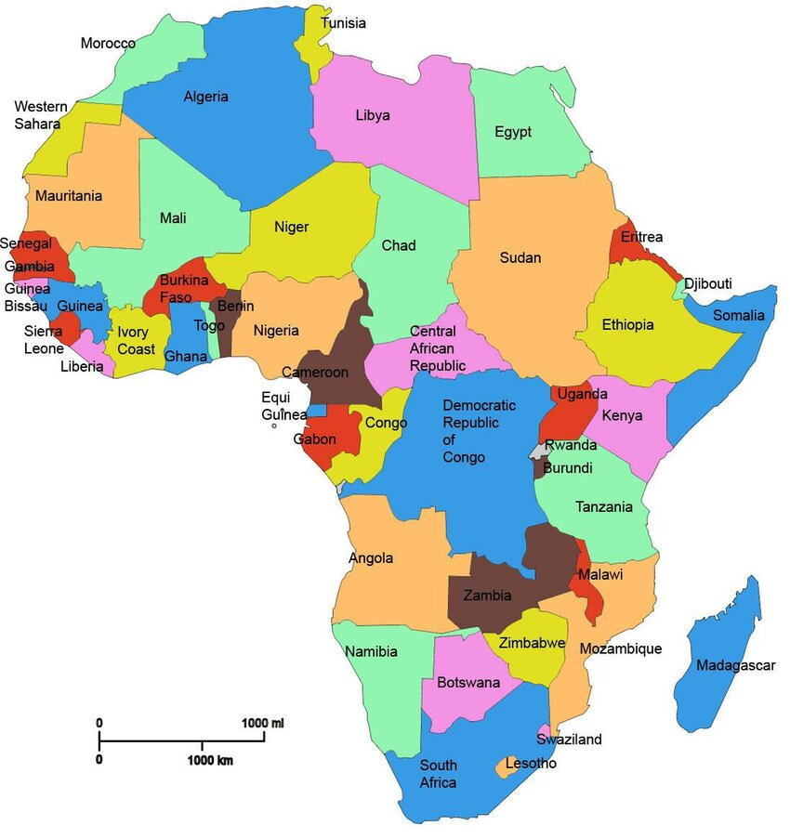
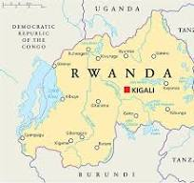
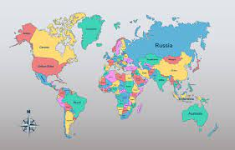
About Rwanda
Rwanda( Land of Thousand Hills), is situated in East – Central Africa.
Capital: Kigali
Area: 26,338 sq. km
Population: 14 million
Population Density - 571 people per Km2
Languages: Kinyarwanda, French, English, Swahil
Life expectancy: 65 years (men) 69 years (women)

Slide 3
Rwanda – A Brief Historic and Political Profile
In the pre-colonial Rwanda, Hutus and Tutsis were the two prominent ethnic groups .
Twas are believed to be the first inhabitants (Rennie, 1972).
Twa community engaged in hunting and gathering of food and pottery.
Between 400 – 1000 AD (CE), migrants from Central Africa entered Rwanda and they brought with them extensive knowledge of farming and agriculture and they were identified as Hutus.
Between 1400 and 1500 AD (CE), cattle herding pastoralists made their way to Rwanda and they came to be later identified as Tutsis.
In 1899, Germany became the first European nation to colonize Rwanda.
Belgian occupation in Rwanda began in 1919 under the tutelage of League of Nations.

Slide 4
Rwanda – A Brief Historic and Political Profile(Cont….)
The Belgian colonizers propagated the “Hamitic Myth” favoring Tutsis and introduced the identity cards to institutionalize the Tutsi and Hutu identities, with this the colonial masters laid the groundwork for the 1994 Genocide (Phillips, 2009 and Zaidi, 2021).
On July 1, 1962, Rwanda became an Independent state.
In 1962, Gregoire Kayibanda, belonging to Hutu ethnic group became the first President.
In 1973, a military coup led by and General Juvénal Habyarimana (also a Hutu) toppled the Kayibanda government and seized power.
Hutus after seizing the political power recontextualized the “Hamite Myth” resulting in discrimination and killings of Tutsis by the first and second Hutu governments.
1993 Arusha Accords
1994 Genocide

Slide 5
1994 Genocide
On April 7, 1994, exactly 30 years ago, a mass Genocide began in Rwanda
Close to 800,000 people, one tenth of Rwanda’s population were killed in 100 days,
One among the darkest moments in the human history.
The immediate reason for the Genocide was the ethnic violence that broke out after an aircraft carrying the then Rwandan President Juvenal Habyarimana and Burundi’s President Cyprien Ntaryamira was shot down by a missile near Kigali, the Capital of Rwanda.
Nearly 70 % of the Tutsi population was wiped out in the Genocide.
The 100 days of slaughter saw neighbors turning on neighbors and friends turning on friends.

Slide 6
1994 Genocide (Cont….)
Rape, sexual torture, mutilation, and enslavement were used as weapons to attack, terrorize and slaughter thousands of Tutsis.
It has been estimated that more than 250,000 women were raped during the Genocide.
Romeo Dallaire in his book Shake Hands with the Devil: The Failure of Humanity in Rwanda wrote: “Still at its heart, the Rwandan story is the story of the failure of humanity to heed a call for help from an endangered people,” (Dallaire, 2004).
Rwanda’s colonial past had a greater role in spreading hatred and venom between majority and minority communities in the country (Mamdani, 2001, Semujanga, 2003, Rusagara, 2012 and Schimmel, 2021).
Genocide destroyed the social, moral, and ethnic fabric of the Rwandan society.

Slide 7
Post- Genocide Rwanda
Between 1990 and 2017, Rwanda’s HDI doubled from 0.250 to 0.524; in 2021, it stood at 0.534.
GNI per capita changed about 19.51 % between 1995 and 2021.
“Rwanda’s recovery from the 1994 Genocide and its rapid economic growth, about 8 % on average over last 15 years, continues to be an inspiration to developing countries around the world,” (UNDP, 2021).
Rwanda is also a global leader in health care in the East African region .

Slide 8
Post- Genocide Rwanda(Cont….)
The Multidimensional Poverty Index in Rwanda declined from 0.461 in 2005 to 0.231 in 2021 (Oxford Poverty and Human Development Initiative- Global MPI Country Briefing, 2023)
Human Development Index, Female HDI value is 0.524 as against 0.569 for Males.(2022)
The GDI value of 0.921.(2022)
Rwanda has the highest % of Women Legislators in the world (49/80).
More than 50% Judges in the Rwanda Supreme Court are women.

Slide 9
Role of Home-Grown Solutions (HGSs) in Building the Post – Genocide Rwanda
Locally engineered policy innovations popularly known as “Home-Grown Solutions” (HGS) helped in the resurrection of Rwanda.
Girinka (One Cow Per Family)
Umuganada (Community Work)
Gacaca (Community Courts)
Ubudehe (Collectively Solve Problems)
Imihigo (Performance Contracts)
Tubarerere Mu Muryango (Let us Raise Children in Families)
Itorero (Civic Education)
Ingando (Solidarity Camp)

Slide 10
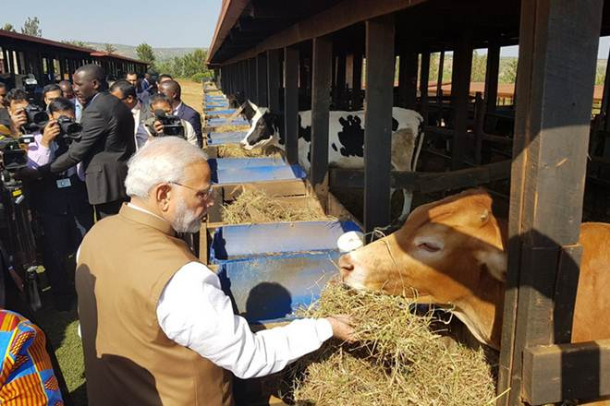
Impact Made by Home-Grown Solutions in Rwanda
1. Girinka
Launched in 2006.One cow per family
To promote unity and reconciliation among Rwandans based on the cultural principle that if a cow is given from one person to another, it establishes trust and respect between the giver and the beneficiary (RAB, 2013; Hahirwa & Kalinganire, 2017; KIM et al. 2011).

Slide 11
Objectives of Girinka Programme
Reduce poverty through dairy cattle farming
Improve nutritional standards
Ensure food security
Improve livelihoods through increased milk consumption and income generation;
Improve agricultural productivity through the use of manure as fertilizer;
Improve soil quality and reducing erosion through the planting of grasses and trees

Slide 12
Impact Made by Girinka Programme
Girinka have contributed to the reduction of extreme poverty for 31.40 % of households. Found that the implementation has contributed to the reduction of poverty.
Contributed to an increased household maize yield by about 26% (from 1,040 kg/ha to 1,309.9kg/ha) (Mugabo et al., 2019).
Improved household daily calorie intake per adult-equivalent by about 14% (from 1,876 Calories/ad-eq/day to 2,142 Calories/ad-eq./day) Improved household nutrition in terms of reduction of underweight and stunting status of under-five children
Increased household annual income by about 129%
On average, the Girinka program beneficiaries receive 4.5 litres of milk per day in 2015, 4.9 liters in 2016, and 4.2 liters in 2017 from their cow with an average lactation period of 184 days per year. Average gross revenue from milk of Rwf 21, 529 per year (Mugabo et al., 2019).82% of households consumed own produced milk while the remaining household consumed milk from neighbours (8%) / from local markets (9.1%).

Slide 13
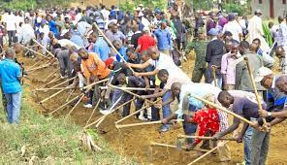
2. Umuganada (Community Work)
One of the traditional tools of mutual help rooted in Rwandan culture.In the post-genocide period, Umuganda was reintroduced as means of the social and economic reconstruction .
Umuganda comes as a forum in which public policies are communicated and explained to the population, and community members discuss the problems that they are facing and propose possible solutions (Anastase, 2014). Public Sphere ?Fostering Social Capital ?
In 2005, Umuganda policy was adopted. It takes place once a month on the last
Saturday ( 8:00 am to 11:00 pm)
As per the policy, “every Rwandan of at least 18 years and who is not above 65 years with the ability to work shall have the obligation to perform community works”.
The level of citizen participation in Umuganda has increased from 87.8% in 2013-2014 to 91.3% in 2015-2016. (Umuganda Annual Report, 2016).

Slide 14
Objectives of Umuganada (Community Work)
Support the development of socio-economic infrastructure .
Contribute to the social cohesion of the through mutual help, by working together and solving community problems.
Promote development activities supporting the national budget and to provide an opportunity for friendliness among people.
Supplement national resources by executing specific activities.
Instill a culture of collective action in the population.
Resolve problems faced by the population with the use of locally available resources.
Restore the dignity of manual labour.

Slide 15
Impact Made by Umuganda (Community Work) Programme
Collective work projects of Umuganda has constructed 3,170 classrooms between 2006 and 2017 brought basic education infrastructure closer to where it was most needed ( UNDP, 2021).
9 and 12-Years Basic Education programme in Rwanda was implemented via Umuganda and it contributed around 62 % of the total cost of classrooms constructed (Rwandan Governance Board, 2017).
There has been a significant increase of Umuganda monetary value, from 4 billion Frw in 2007 to 19 billion Frw in 2016 (Rwanda Governance Board, 2017).
The increase of “Umuganda monetary value” denotes that the economic benefits of Umuganda multiplied almost 5 times in just one decade.

Slide 16
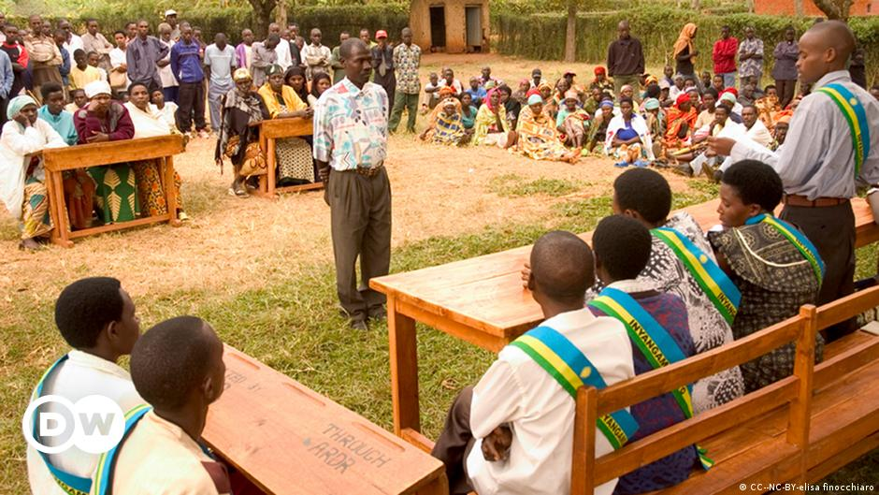
3. Gacaca (Community Courts)
Gacaca is rooted in Rwanda’s traditional dispute resolution mechanism
Like South Africa’s Truth and Reconciliation Commission, Gacaca courts in Rwanda allowed communities to confront the past and develop a collective account of the violence that had occurred (Longman, 2009).
Gacaca Courts were established in 2001, began to operate on a trial basis in 2002 and eventually came to operate as trials throughout the country by early 2007 (Geraghty, 2020).
In the Gacaca system, communities at the local level designate judges to hear the trials of genocide
suspects accused of all crimes except planning of genocide.

Slide 17
Objectives of Gacaca (Community Courts)
Foster restorative justice (restorative rather than retributive justice)
Guarantee accountability for the genocide.
Promote reconciliation and peace building
Pursue criminal prosecution as a means of promoting the reconstruction of Rwandan society (Longman, 2009).
Promote accountability and the rule of law.
Speed up the prosecution of those accused of genocide crimes.

Slide 18
Impact Made by Gacaca Courts
Since 2005, just over 12,000 Gacaca courts have tried approximately 1.2 million cases, (Human Rights Watch, May 31, 2011).
The courts give lower sentences if the person is repentant and seeks reconciliation with the community. Often, confessing prisoners return home without further penalty or receive community service orders .
Allowed victims to confront perpetrators in public and have communities recognize their suffering, thus allowing them to move on. Because Gacaca would allow those who confessed to receive a reduced sentence and be more quickly reintegrated into their communities (Longman, 2009).

Slide 19
4. Ubudehe (Collectively Solve Problems)
Ubudehe is a Rwandan social protection system of intra-community co-operation based on collective actions (Niringiye and Ayebale, 2012).
A socio-economic stratification system in which poor Rwandans are supported with social protection schemes (Alexis, 2023).
In 2001, Ministry of Finance and Economic Planning in partnership with Ministry of Local Government launched the Ubudehe project.
Communities to collectively solve problems related to poverty. As a form of social capital, Ubudehe involved trust and reciprocity (Alexis, 2023).
Initiated and implemented by the decentralized administrative entity nearest to the recipients, i.e. the cell/villages (Niringiye and Ayebale, 2012)

Slide 20
4. Ubudehe (Collectively Solve Problems)(Cont…..)
Initially, Ubudehe focused on agricultural activities to ensure timely agricultural operations for food security purposes and house building activities.
At present, Ubudehe gives emphasis to construction and repair of rural roads and other infrastructure, construction of administrative infrastructure such as office buildings.
Under Ubudehe, there is a provision for bank account to each community and it has facilitated thousands of community-led actions such as purchasing livestock, undertaking agricultural activities, building clean water facilities, classrooms, terraces, health centers as well as silos for storing produce (Alexis, 2023).
Ubudehe has won the prestigious UN Public Service Award due to the participation and ownership of millions of citizens and the strong support of the Authorities of Rwanda for poverty alleviation.

Slide 21
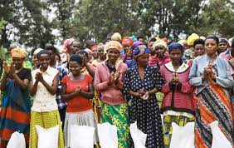
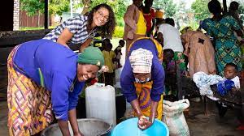
Objectives of Ubudehe
To fight poverty through collective action and participatory development.
To promote mutual assistance among people living in the same area in order to solve their socio-economic problems.
To empower Rwandans through strengthened collective action for a real partnership with the Government in the fight against poverty.
To reinforce the framework of community participation.

Slide 22
Impact Made by Ubudehe
Estimations show that at least 1.4 million people (the lowest estimation) have been direct beneficiaries of Ubudehe (Niringiye and Ayebale, 2012).
Ubudehe concepts and procedures has contributed to the improvement of local community skills, the capacity of self-management and the ability to acquire new skills , (Niringiye and Ayebale, 2012).
Between 2012 and 2017, annual public spending on the social protection sector increased rom Rwf 64 billion to over Rwf 130 billion (Alexis, 2023).
Generation of 4805 temporary or more long-term jobs, through the construction of classrooms, health centres, roads and bridges, mills, electricity and water infrastructures, as well as the creation of radical terraces (Alexis, 2023).
Among 385 respondents found that 95% confirmed that their incomes had improved; within that, about 71 % consider that their income had doubled and 22 % consider that their income had more than tripled (Havugimana, 2023).
The success recorded under CBHI have been linked to Ubudehe. ( Will Discuss on CBHI)

Slide 23
5. Imihigo (Performance Contracts)
Imihigo is based on a pre-colonial tradition where individuals or communities would publicly promise to complete certain tasks, sometimes set by the king or leaders. If the they achieved their goal, the community celebrated their success; if they failed to follow through, they faced public humiliation (Ndahiro 2015).
In 2006, the Paul Kagame government reintroduced the modern version of Imihigo to hold public officials accountable, and to adapt the idea of performance contracts to a traditional practice of setting and achieving goals.
First implemented with district mayors, Imihigo were later expanded across government ministries and agencies.

Slide 24
5. Imihigo (Performance Contracts)(Cont…)
Imihigo was designed as a Rwandan approach to performance management, as described in a policy note published by the Ministry of Local Government in 2006:
“The Imihigo approach shares many characteristics with results-based management tools. 1, each Imihigo identifies a set of clear priorities. 2, each Imihigo presents a set of specific targets backed by measurable performance indicators. 3, each Imihigo undergoes evaluation. 4, each Imihigo constitutes an efficient accountability mechanism and an incentive for local government leaders and their population to implement the decentralization policies and to meet local and national development targets,”

Slide 25
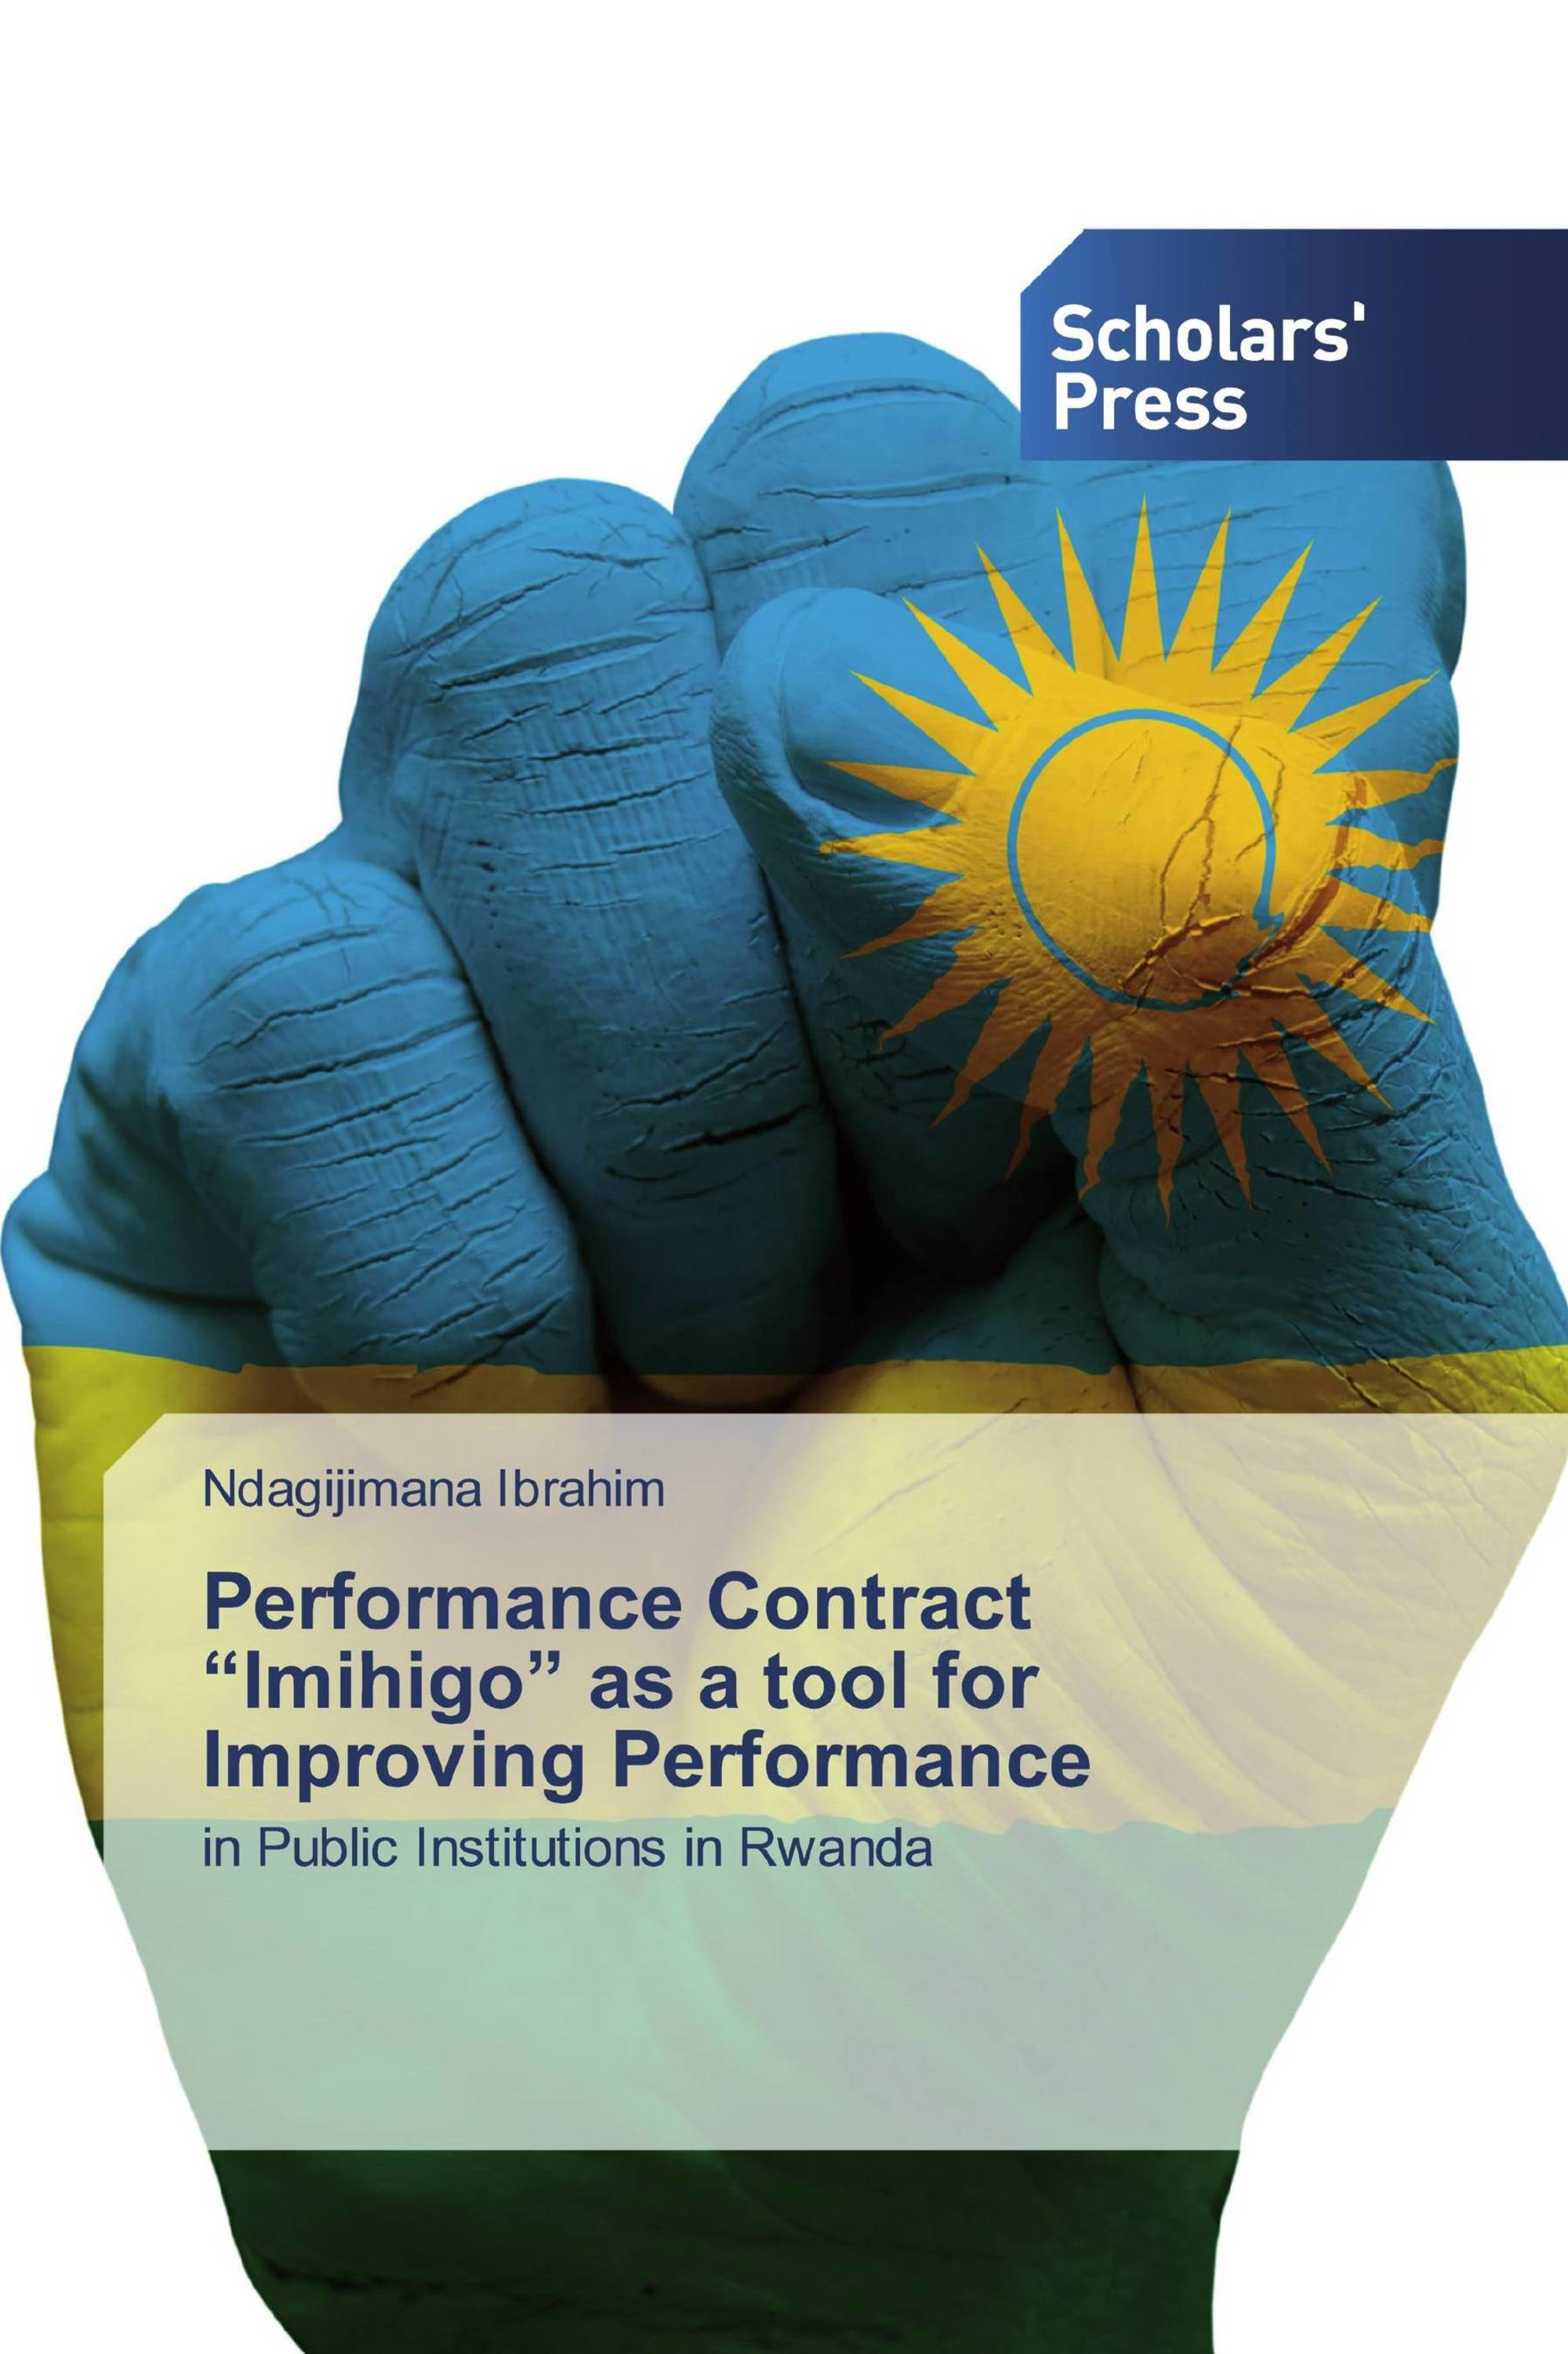
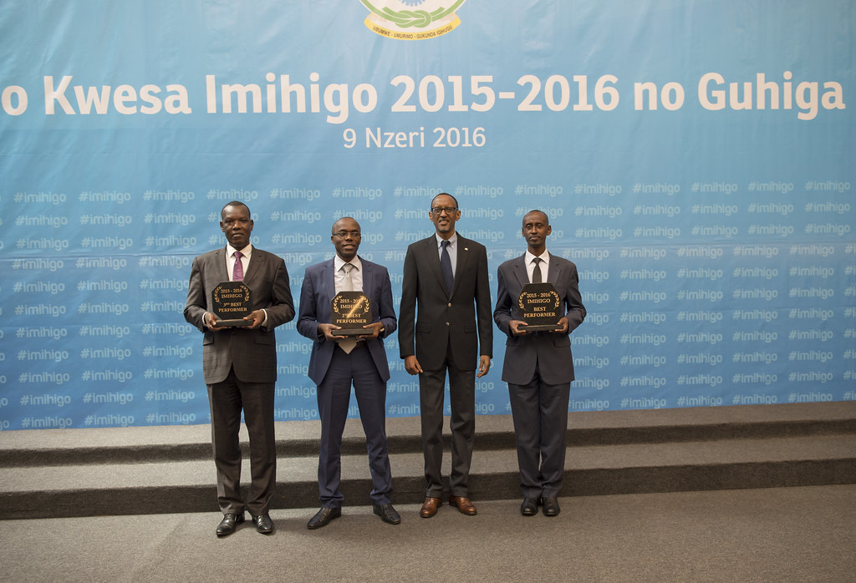
Objectives of Imihigo
Speed up implementation of the local & national development agenda.
Ensure stakeholder ownership of the development agenda.
Promote accountability & transparency.
Promote results-oriented performance.
Encourage competitiveness & evaluation
Ensure stakeholders’ participation & engagement in policy formulation.
Enstill a culture of regular performance evaluation.

Slide 26
Impact made by Imihigo
The increased focus on performance of public officials helped Rwanda achieve impressive rates of economic growth, rapidly improve infrastructure, and increase health and education outcomes for its citizens, (World Bank, 2019)
The political leadership recognized the gap between the country’s development vision and the outcomes on the ground, and initiated an outreach to Distract Mayors to bring them into a new partnership to deliver on district-level development plans, (World Bank, 2019)
Scrutiny from the president and other high-level officials put pressure on government workers at every level to perform (World Bank, 2019)
Incentives are a key element of the Imihigo contracts and critical to the reform’s success. Mayors around the country had to report progress to the central government, and evaluations were conducted by a special team each year. All districts were scored on their performance, and top performers received special recognition from the President in a dedicated awards ceremony.
Public recognition of achievement also helped create positive competition among Mayors to do even better.

Slide 27
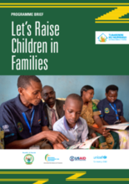
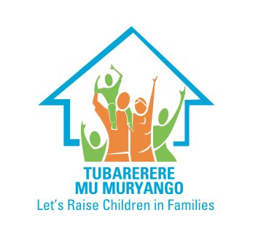
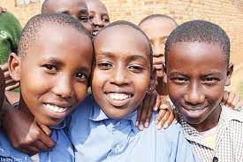
6. Tubarerere Mu Muryango (Let us Raise Children in Families)
Rwandan Ministry of Gender and Family Promotion and Hope and Homes for Children in 2011-2012 found that many children and young adults are living in government-registered facilities/institutional care alone.
The use of institutional care also contradicts Rwandan cultural norms around the value of the family, and government policies.
To ensure all children can grow up in safe and protected families, in 2015, the Rwandan government in collaboration with UNICEF, established the Tubarerere Mu Muryango (TMM)

Slide 28
Objectives of Tubarerere Mu Muryango(TMM)
To ensure all children living in institutional care are reunited with their families or placed in suitable forms of family-based alternative care.
To strengthen the National Commission for Children (NCC) and to develop national standards and guidance on children’s care.
To recruit and train professional social workers and psychologists, and absorbing these professionals into the civil service.
To provide support packages to the families of reintegrated children, to young adults leaving care to live independently and to 1,000 foster caregivers.
To prevent further institutionalization, including awareness-raising and the use of short-term emergency foster care
To enable 29,674 community volunteers (Friends of the Family) to monitor vulnerable children and families, help prevent unnecessary separation and reintegrate children into family care.
To develop case management and monitoring and evaluation systems.

Slide 29
Outcomes of Tubarerere Mu Muryango(TMM)
Reduction in the number of children in institutional care: Close to 70 % of children had left institutional care and been reintegrated into families or placed in foster care (NCC , UNICEF, USAID, 2019).
Stronger commitment from the part of government in introducing childcare reforms and in creating a dedicated professional child welfare workforce: National Commission for Children (NCC) is now a fully functioning government agency with a cadre of professional social workers and psychologists.
Cooperation and transformation of institutional care: Many care homes were transformed into community outreach centres, providing family support, schooling and early childhood development interventions.
A total of 29,674 community volunteers were recruited and trained.
It is more close to Gary S Becker ( A Treatise on the Family )?

Slide 30
7. Itorero (Civic Education)
Education at Itorero was a formal training in Rwanda’s rich pre-colonial political culture
Modernized Itorero program began in 2007.
In the post -Genocide era, the Rwandan government attributed great importance to the elimination of the still-existing ethnic and cultural divisions
Civic education inculcate the spirit of national unity and patriotism.
Unification of society through civic education as a priority goal, in which intercultural education plays an important role.
The pillars of civic education include (i)history, (ii)culture, (iii)national values, and (iv) the vision of the state.

Slide 31
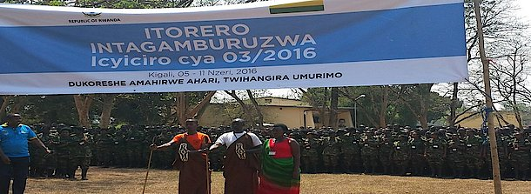
Objectives of Itorero (Civic Education)
To train Rwandans to become patriotic citizens
To rebuild the Rwanda’s social fabric and mobilize citizens to uphold important cultural values and to give a sense of dedication to their country.
To foster unity and reconciliation efforts of the Rwandan government through civic education.
To eliminate still-existing ethnic and cultural divisions.

Slide 32
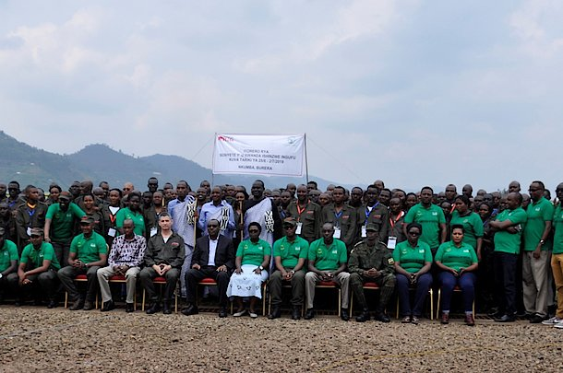
Outcomes of Itorero
Today, Rwanda promotes the concept of “I am Rwandan” or in other words, Rwandan nationality is given utmost importance and it is the only acceptable identity in the country. This is due to Itorero (Civic Education)
The de-ethnicization (Ndi Umunyarwanda) “I am Rwandan, not Hutu, Tutsi, or Twa.”

Slide 33
8. Ingando (Solidarity Camp)
After the genocide of 1994, thousands of prisoners accused of genocidal crimes were transferred to Ingando solidarity camps for re-education and rehabilitation before being released (Hoeksema, 2016).
The National Community and Reconciliation Commission (NURC) is in charge of organizing the Ingando camps.
Ingando originates from the old tradition of kugandika, ( “a halt to one’s usual preoccupations to contemplate issues of great national concern such as war and disaster”)
The process of civic education is carried out through the implementation of a series of initiatives aimed at uniting the antagonized society.
It served to shape the desired civic qualities and the sense of being Rwandan.
History education and the “redefinition” of ethnicity are central to the Ingando program.
Ingando has tailor-made programs for special target groups: politicians, businessmen, teachers, students, demobilized soldiers, and prisoners.

Slide 34
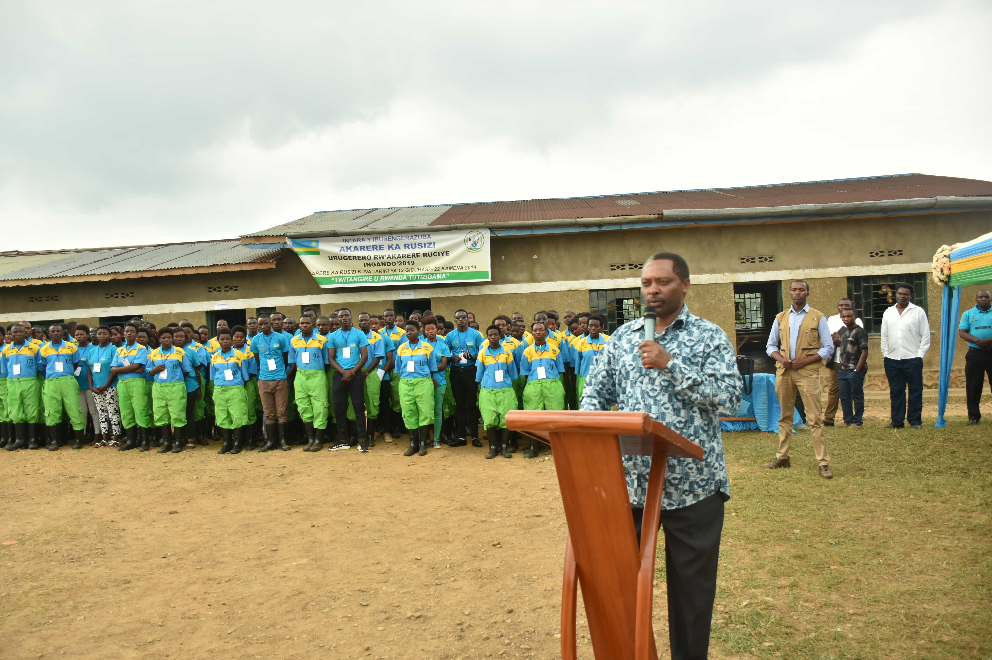
Objectives of Ingando
To eliminate “bad” and “divisive” ideologies and correct “historical and ethnic distortions”.
To give Rwandans a “proper and positive understanding of politics as a way of managing the society and not as a dirty game”.
To help citizens surpass petty thinking and raise them to a new level of competence in the best interest of Rwandans as a whole.
To “inculcate healthy, liberated minds with a clear vision about issues of national interest and development”

Slide 35
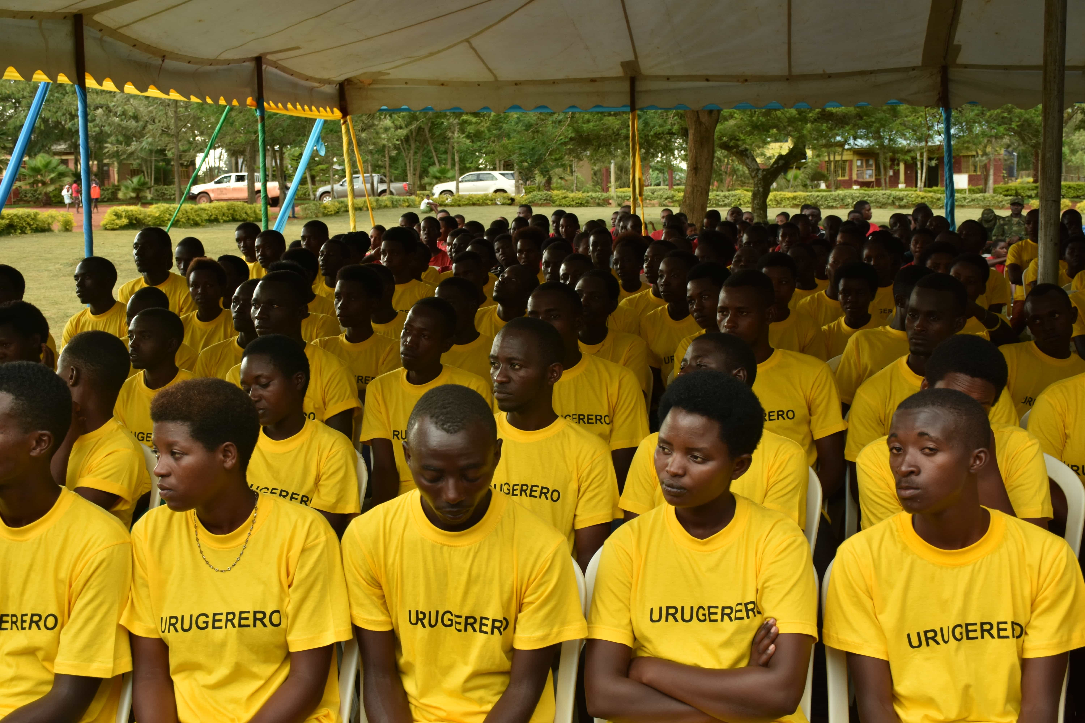
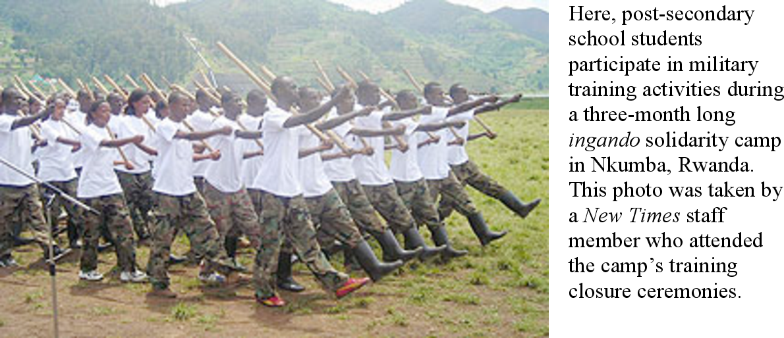
Outcomes of Ingando
The de-ethnicization (Ndi Umunyarwanda) “I am Rwandan, not Hutu, Tutsi, or Twa.”

Slide 36
Community-Based Health Insurance (CBHI)
Rwanda one of the poorest countries in the world achieved the high health insurance enrolment (Chemouni ,2018). The success recorded under CBHI have been linked to HGS and particularly Ubudehe.
In 2001, Rwanda introduced a CBHI) programme which enable citizens to cover the expenses of health care.
.
Today more than 90 % of Rwandan citizens are covered under CBHI.
Had a positive effect on the life expectancy , rising from 49.7 years to 69.6 years between 2001 and 2022 (Sabet et al., 2023).
Rwanda is also one among the sub-Saharan low-income country to meet the SDGs of reducing maternal mortality rate and containing the spread of malaria, tuberculosis and AIDS.
Rwanda spends 7.8 % of its 2020 budget on health care (Sabet et al., 2023).

Slide 37
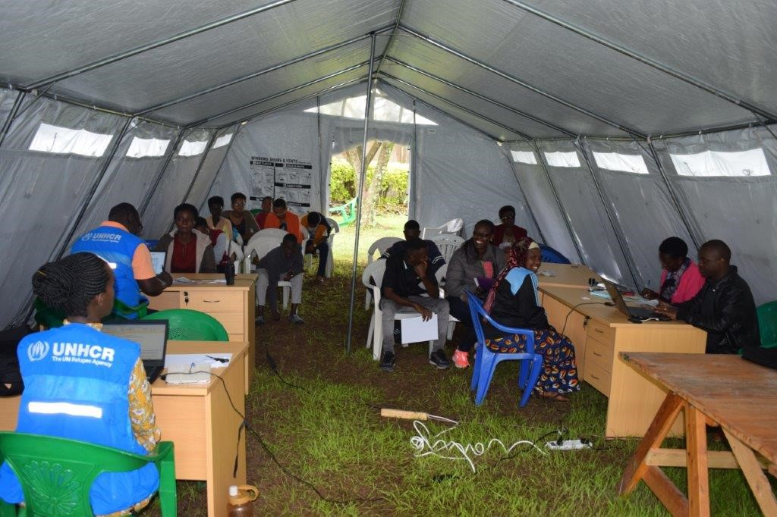
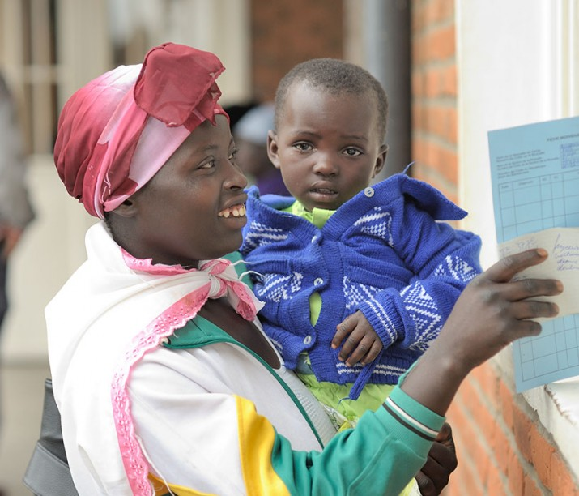
Objectives of CBHI
To build a health-care system through strong leadership, community engagement and collaborative partnerships.
To make health care affordable and accessible.
It could achieve health-care affordability and accessibility in Rwanda.

Slide 38
Conclusion
HGS have helped Rwandans to resolve issues faced in the post-genocide era to a large extent.
Rwanda's development was pioneered by “locally engineered policy innovations” known as HGS.
HGS play an important role in ensuring sustainable development in
Rwanda
Peace-building processes and initiatives in Rwanda was a fruitful result of HGS.
No other country in the world has effectively made use of the power of HGS than Rwanda not only in post-conflict resolutions and reconstructions but also in strengthening political, social, and economic transformations.

Slide 39
Conclusion(Cont…)
HGS in Rwanda has resulted in enhancing participatory and accountable governance, reducing vulnerability, fostering social cohesion and nurturing inclusive human development.
Countries across the world can learn from the experiences emerging from HGS in Rwanda.
Significance of HGS should be seriously discussed by policy makers and academicians, especially its role in reconstructing a post-pandemic world.
More serious research is needed in the area of HGS and decentralization.

Slide 40
Jos Chathukulam
Director
Centre for Rural Management (CRM)
Kerala (India)
Email: joschathukulam@gmail.com

